Slide 1




Wikidata supporting open student research projects in plant chemistry
CEVOpen
WikiDataCon 2021-10-31
Presentation by
CEVOpen Team
2021 - a sustainable future for Wikidata
Notes:
https://en.wikipedia.org/wiki/Wikimedia_Foundation by Unknown Author is licensed under CC BY-SA

Slide 2

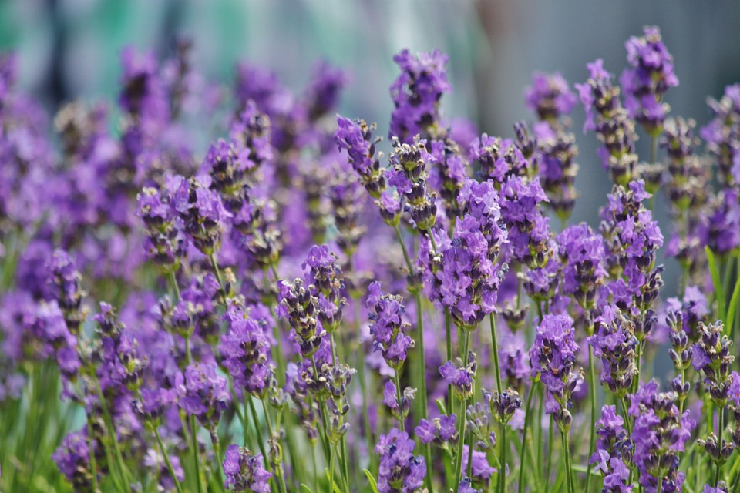
About CEVOpen
2019
Peter Murray-Rust – ContentMine, TDM toolkit
Gitanjali Yadav – EssOilDB, a database
Emanuel Faria– Verriclear, a company
Essential Oil Literature
2021 - a sustainable future for Wikidata
Notes:
This Photo by Unknown Author is licensed under CC BY-SA

Slide 3
Wikidata supporting open student research projects in plant chemistry
WikiDataCon 2021-10-31
Shweata N. Hegde
2021 - a sustainable future for Wikidata
Notes:
https://en.wikipedia.org/wiki/Wikimedia_Foundation by Unknown Author is licensed under CC BY-SA

Slide 4
Presentation Outline
First 5 Min. - Shweata
Why are we mining plant chemistry?
Overview of the workflow
Introduce KARYA Interns
5 – 18 Min. – KARYA Interns
Pre-recorded
Demo the tools
Share experience and challenges
18 – 21 Min. – Sum up
2021 - a sustainable future for Wikidata

Slide 5
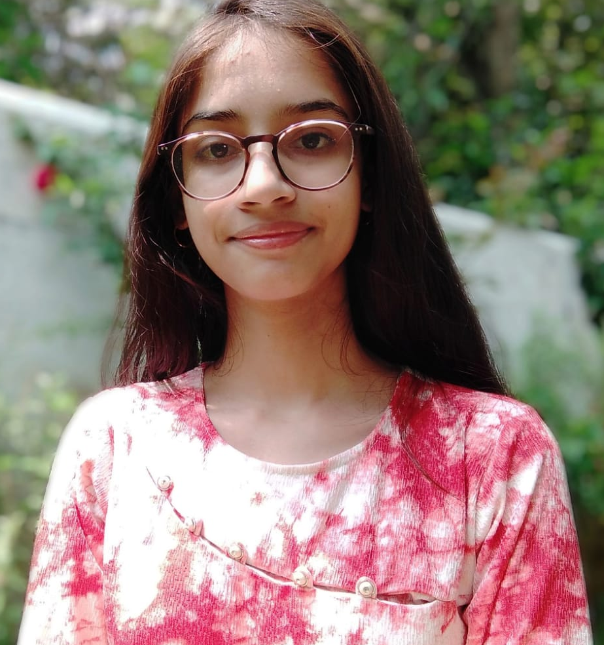
About Me - Shweata N. Hegde (ಶ್ವೇತಾ ನ್. ಹೆಗಡೆ[KN])
3rd year life science undergrad
SciComm + Science Education + Open Science
CEVOpen: Natural Language Processing project - Docanalysis
2021 - a sustainable future for Wikidata

Slide 6

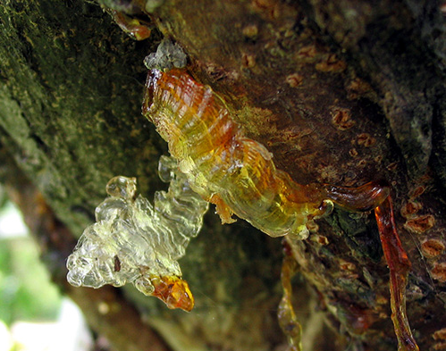
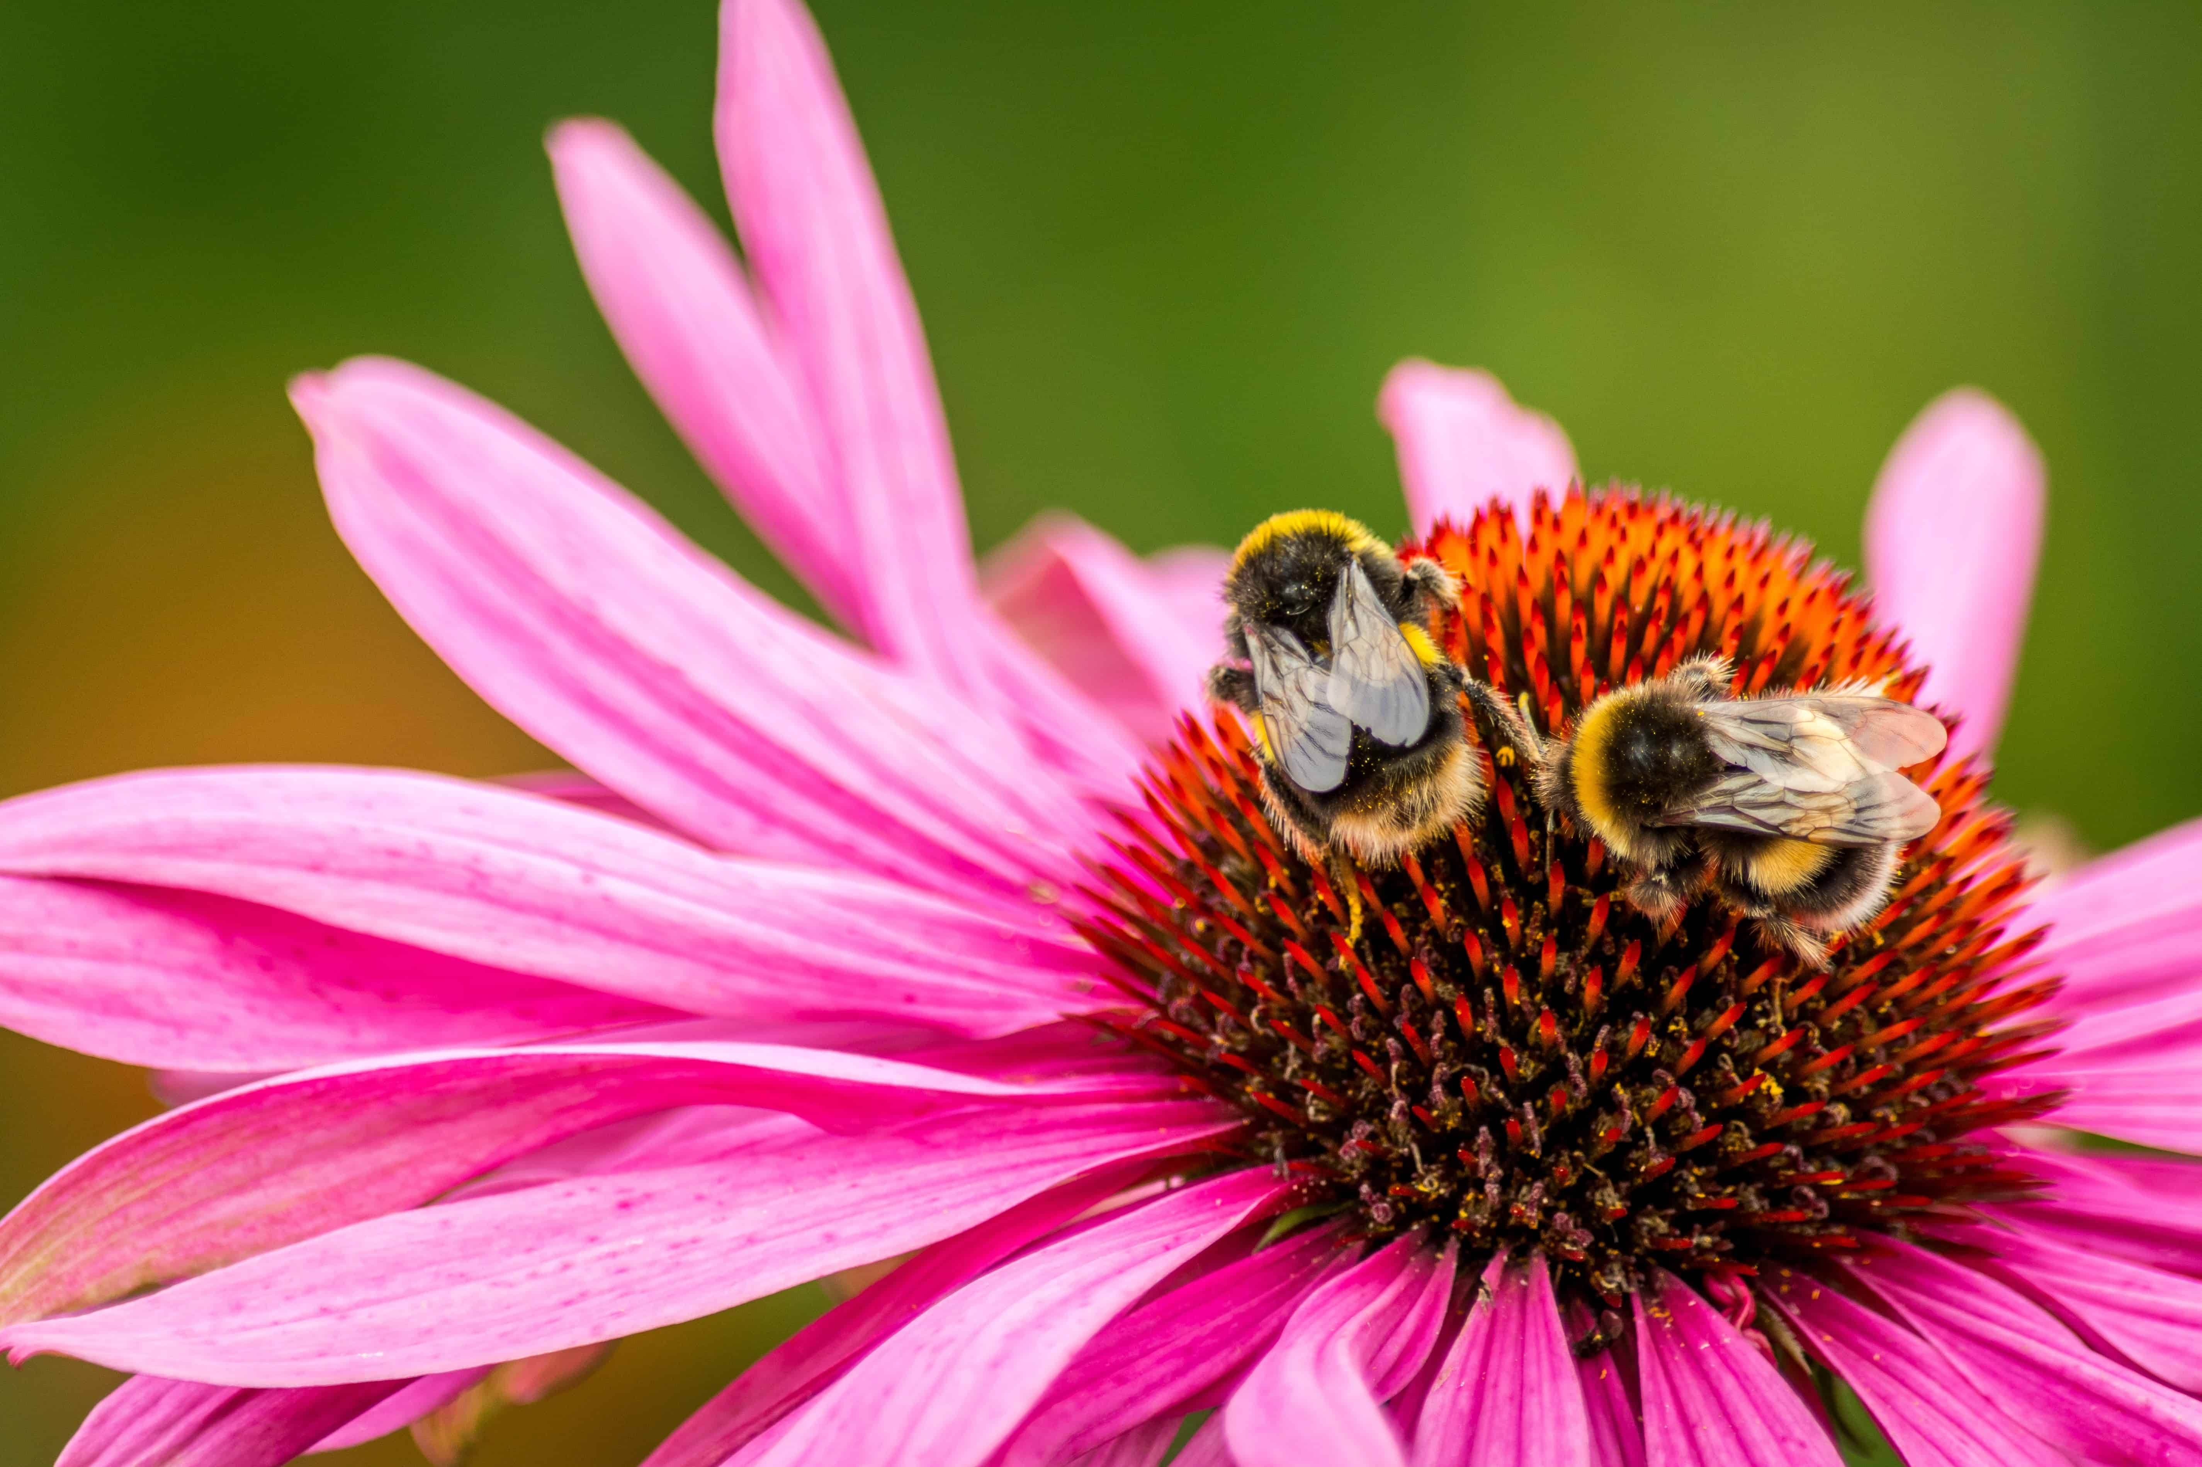


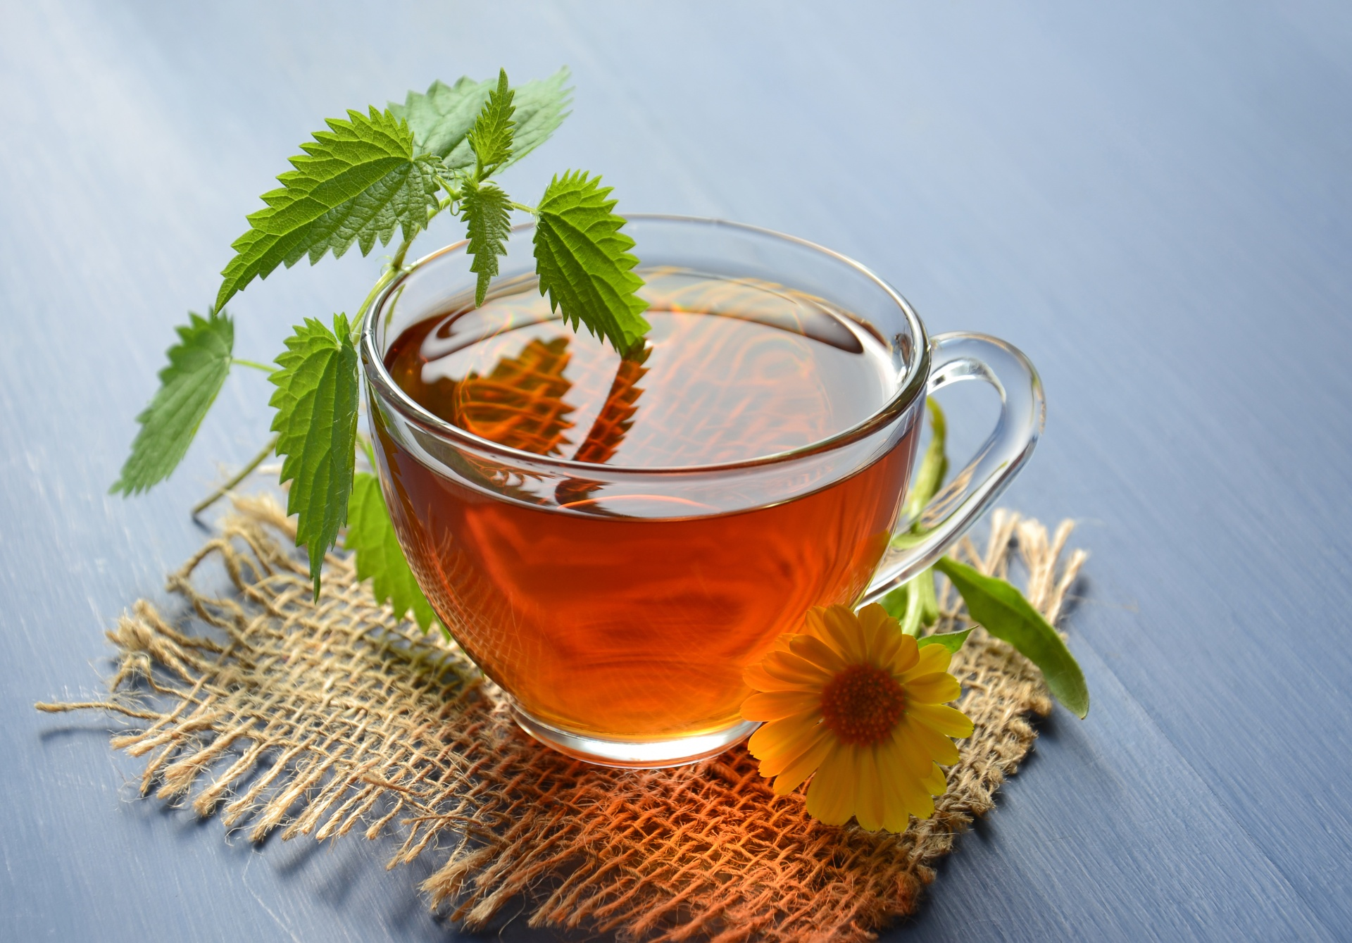
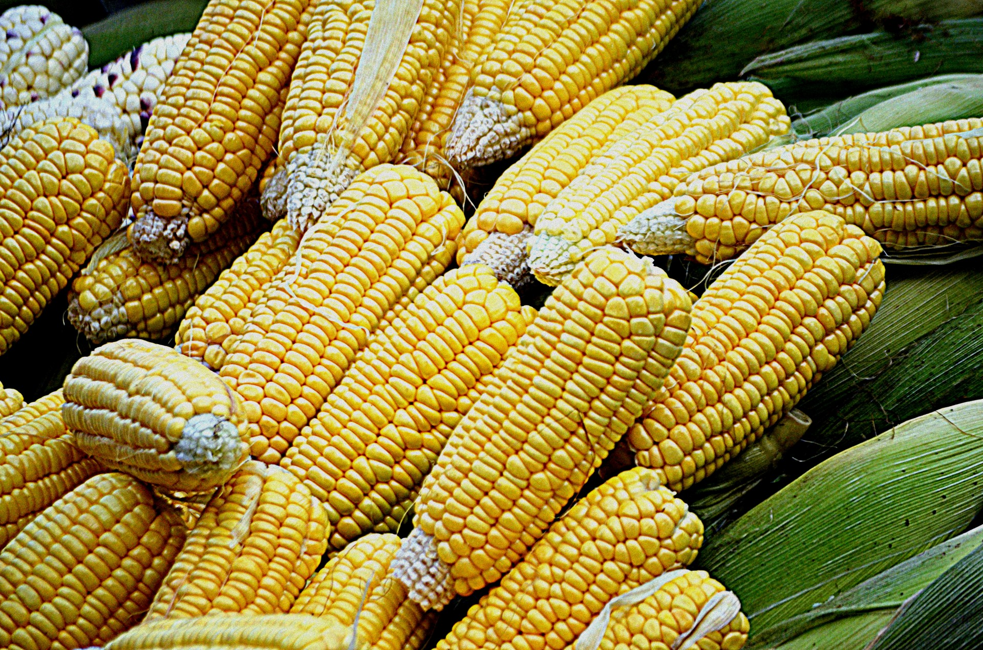
Why Plant Chemistry?
“Plants are better chemists than we are!“
Plants use chemicals to:
communicate
Defend and resist disease
Attract pollinators
…
And for literally everything else!
TERPENES!
Mint पुदिना ಪುದಿನ
>20000 compounds
All have same starter molecule
Based on what enzymes acts on the starting molecules the final product is different
Notes:
This Photo by Unknown Author is licensed under CC BY-SA
This Photo by Unknown Author is licensed under CC BY-SA

Slide 7
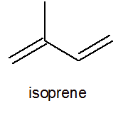
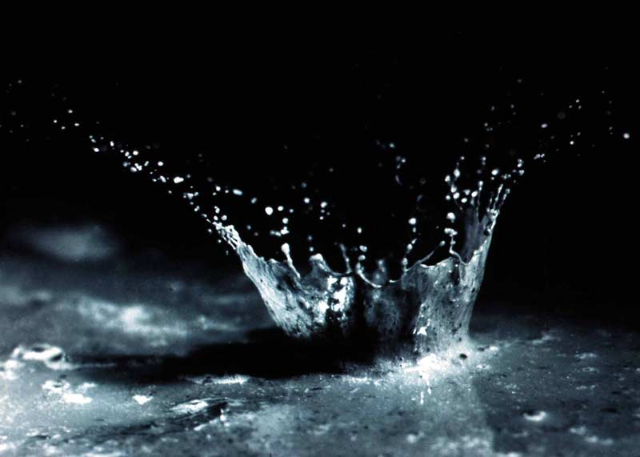
Why Plant Chemistry?
“Plants are better chemists than we are!“
Plants use chemicals to:
communicate
Defend and resist disease
Attract pollinators
…
And for literally everything else!
TERPENES!
>20000 compounds
All have same starter molecule
Based on what enzymes acts on the starting molecules the final product is different
Enzymes
MINT
…
Aromatic!
Notes:
This Photo by Unknown Author is licensed under CC BY-SA
This Photo by Unknown Author is licensed under CC BY-SA
This Photo by Unknown Author is licensed under CC BY-SA-NC

Slide 8
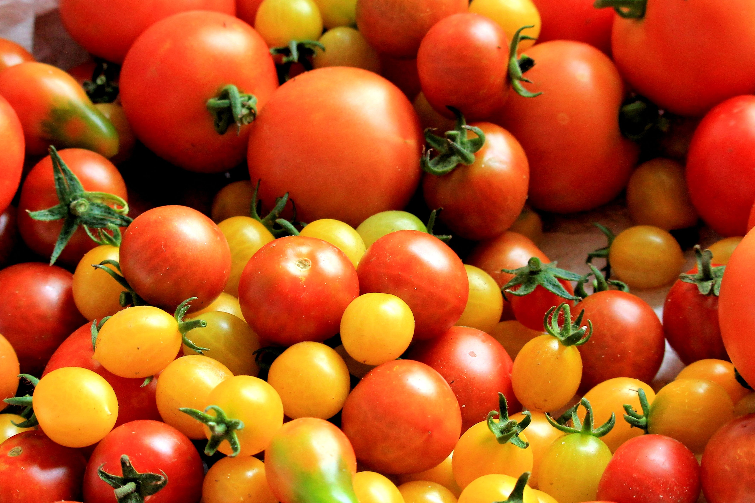
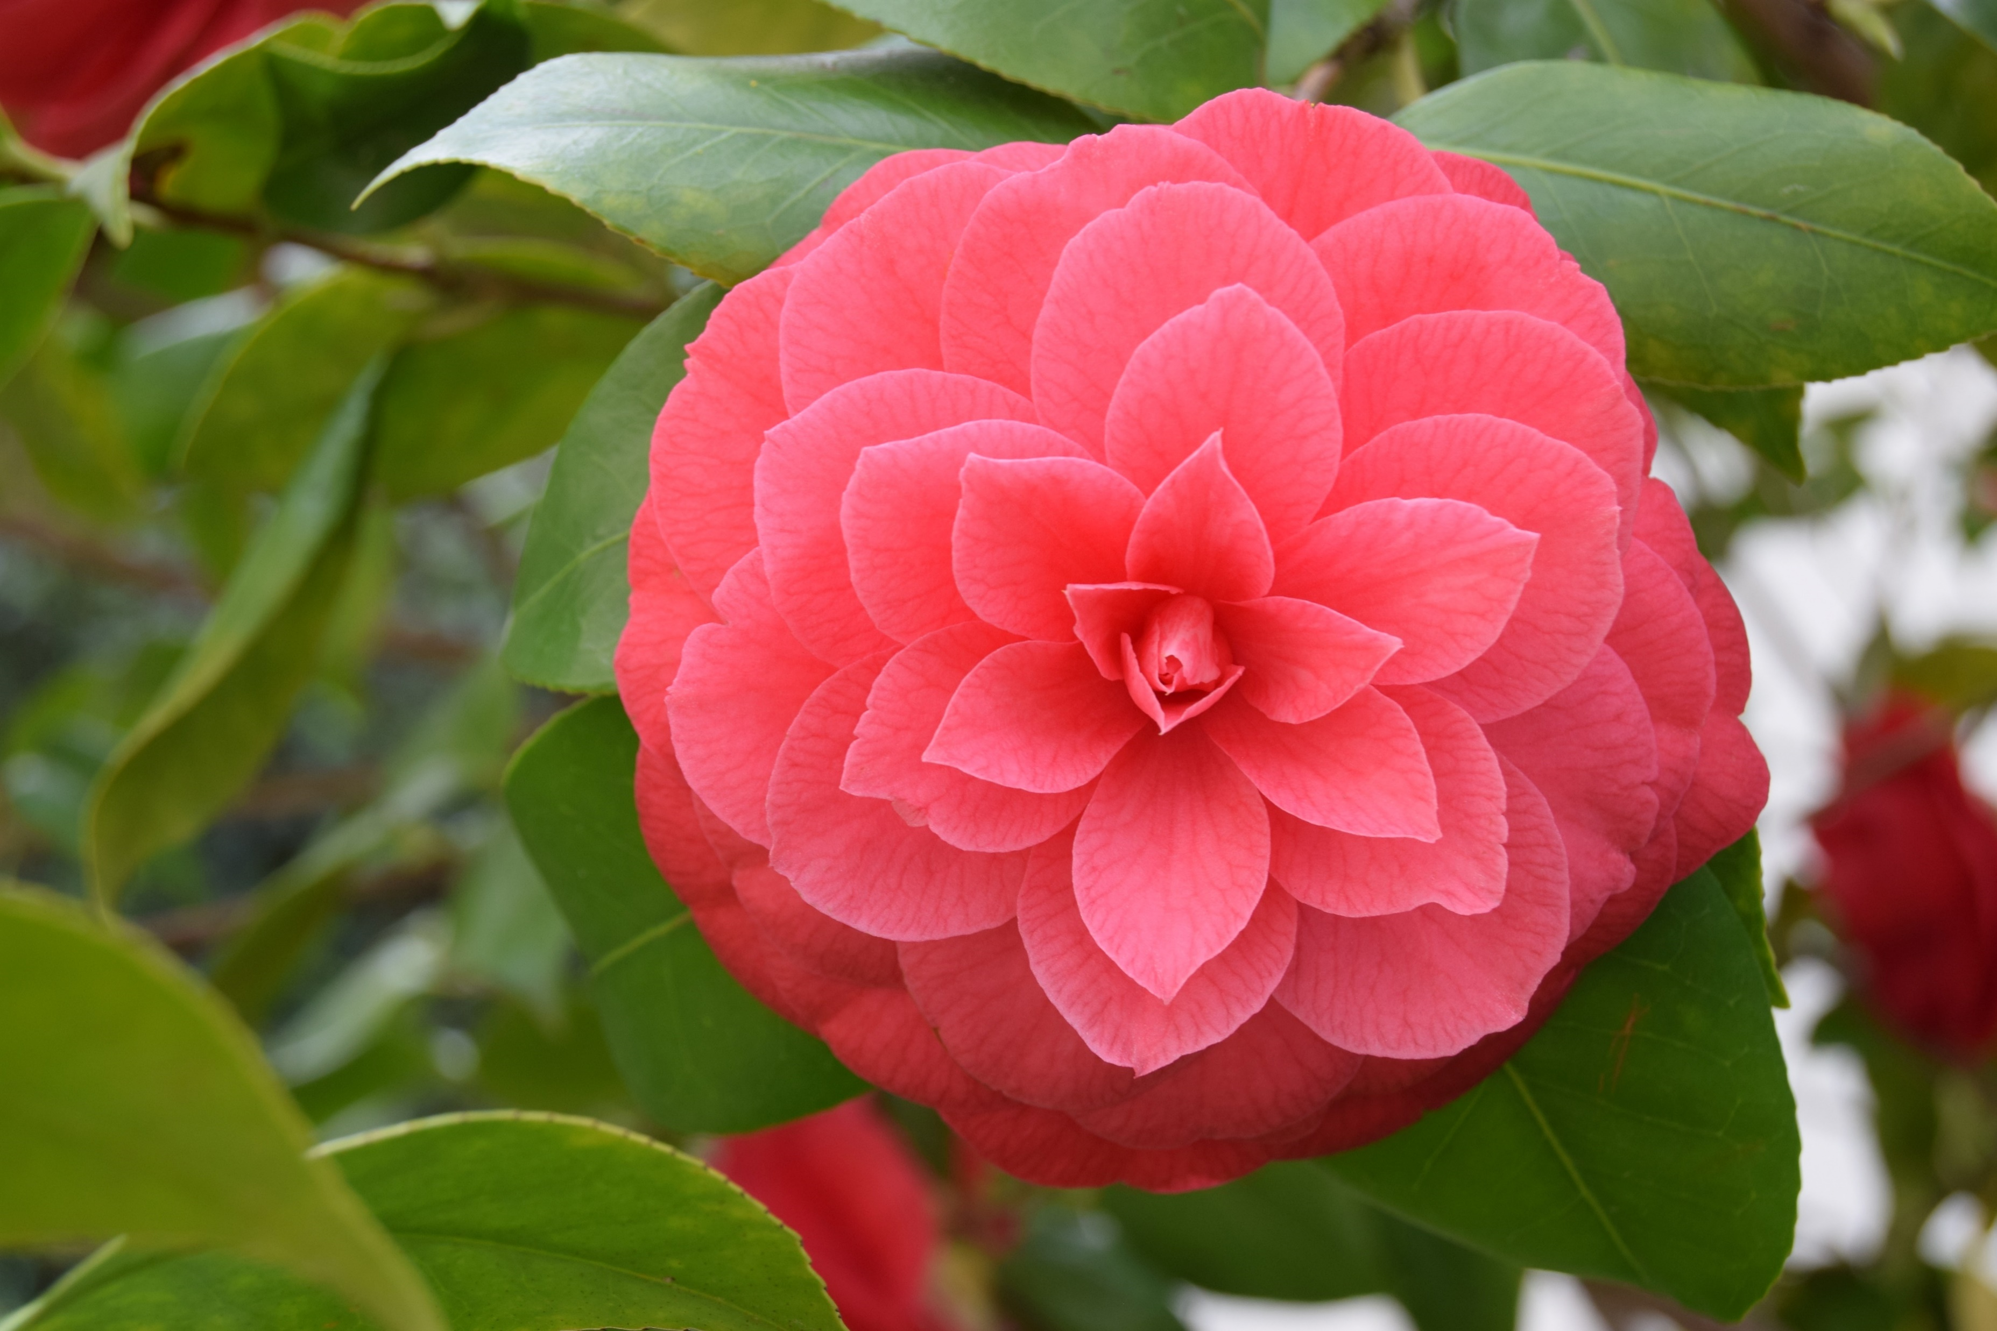
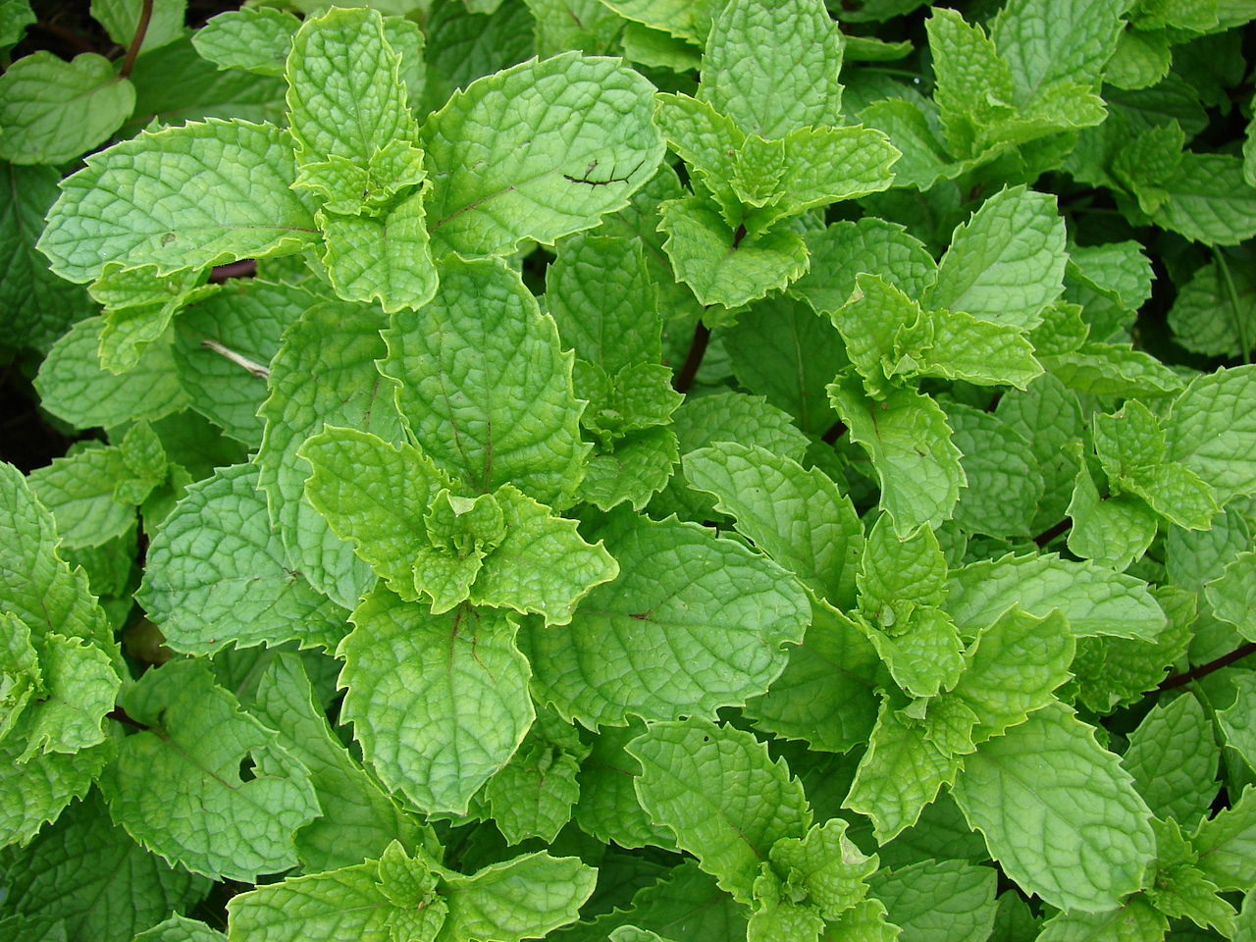
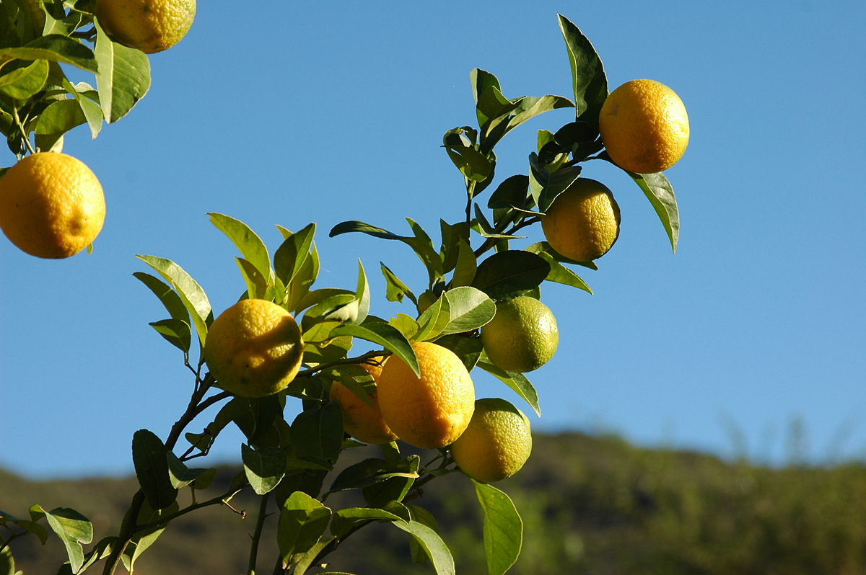
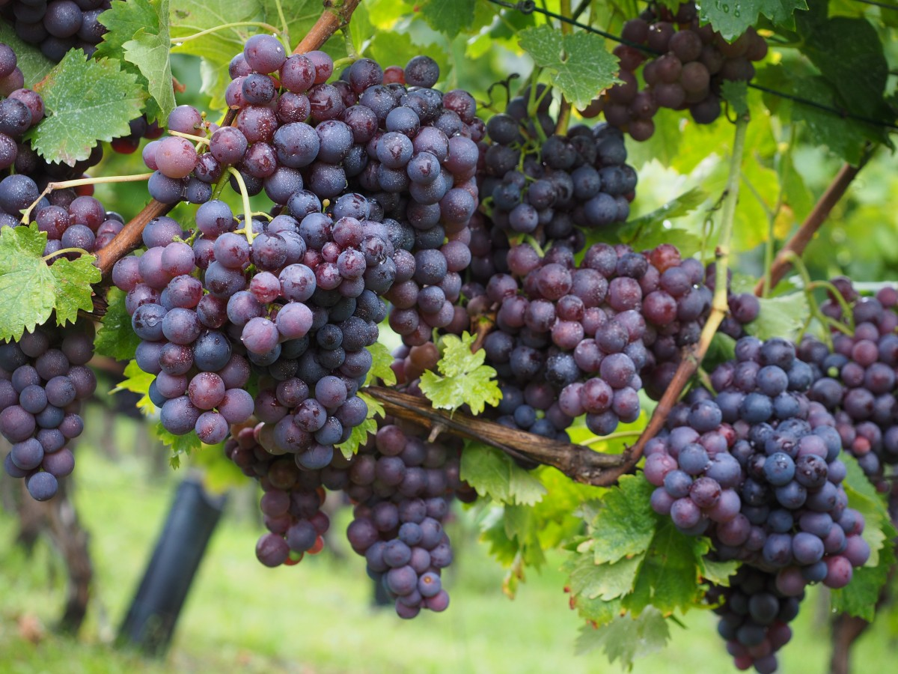
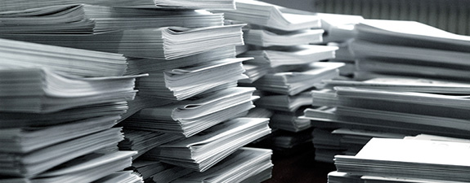
CORN
TOMATO
CAMELLIA
What are the enzymes involved in the terpene synthesis?
We are interested in TERPENES of crops
LEMON
What are its genes?
MINT
GRAPES
Deluge of information in scientific literature, thanks to recent advancement!
But…
This Photo by Unknown Author is licensed under CC BY-SA
Notes:
This Photo by Unknown Author is licensed under CC BY-SA
This Photo by Unknown Author is licensed under CC BY-SA
This Photo by Unknown Author is licensed under CC BY
Change the papers image

Slide 9
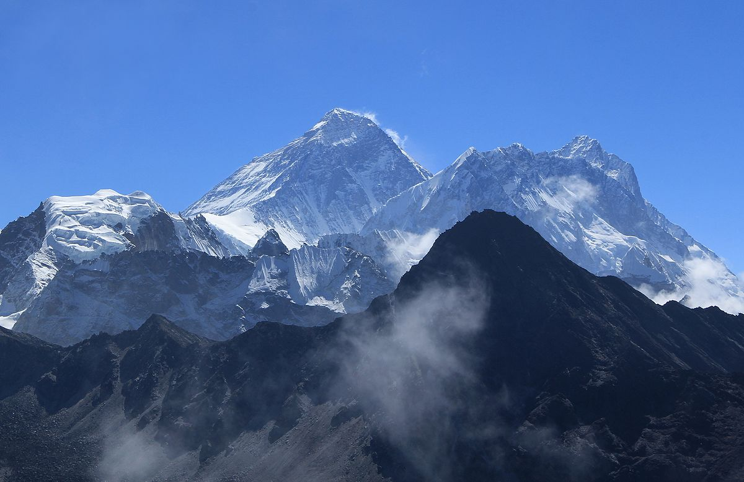
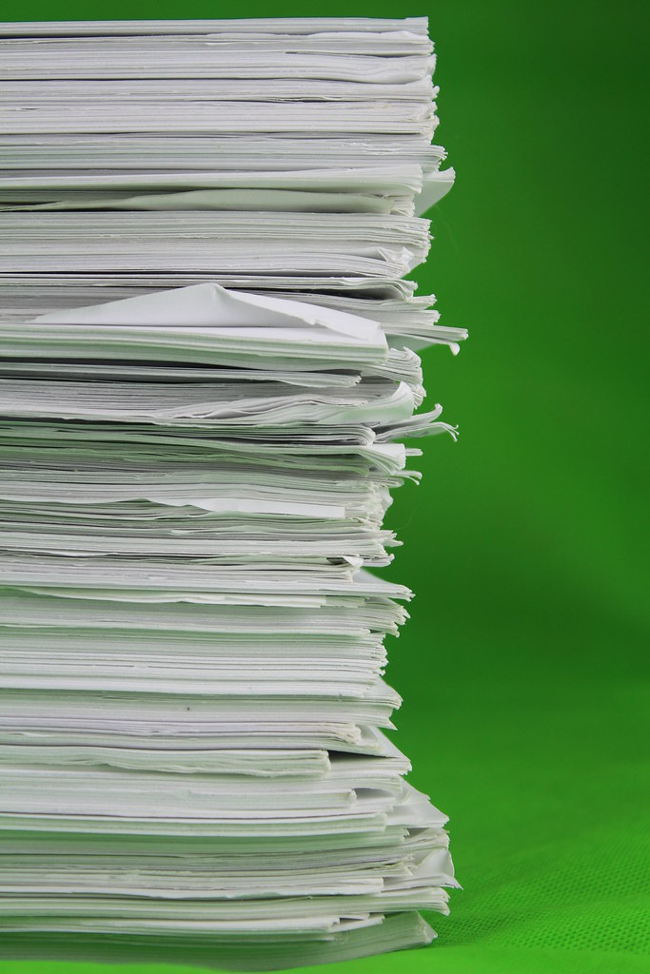
SCIENTIFIC LITERATURE
How big is the scientific literature?
70 Million papers*?!
珠穆朗瑪峰
Mount Qomolangma
Sagarmatha
Mt. Everest
Open
30% Open Access
Scientific literature
closed
Can’t read unless you pay!
One year’s worth of publication in print
*https://blogs.lse.ac.uk/impactofsocialsciences/2020/01/17/not-yet-the-default-setting-in-2020-open-research-remains-a-work-in-progress/
P.S. this is just a back of the envelope calculation!
Notes:
This Photo by Unknown Author is licensed under CC BY
This Photo by Unknown Author is licensed under CC BY-SA
Message in the centre

Slide 10
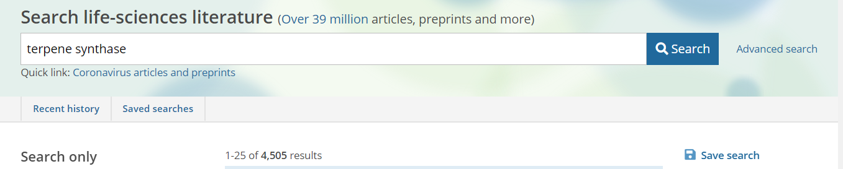

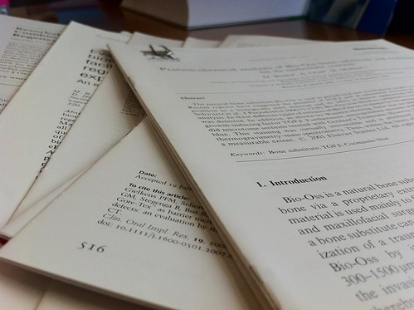
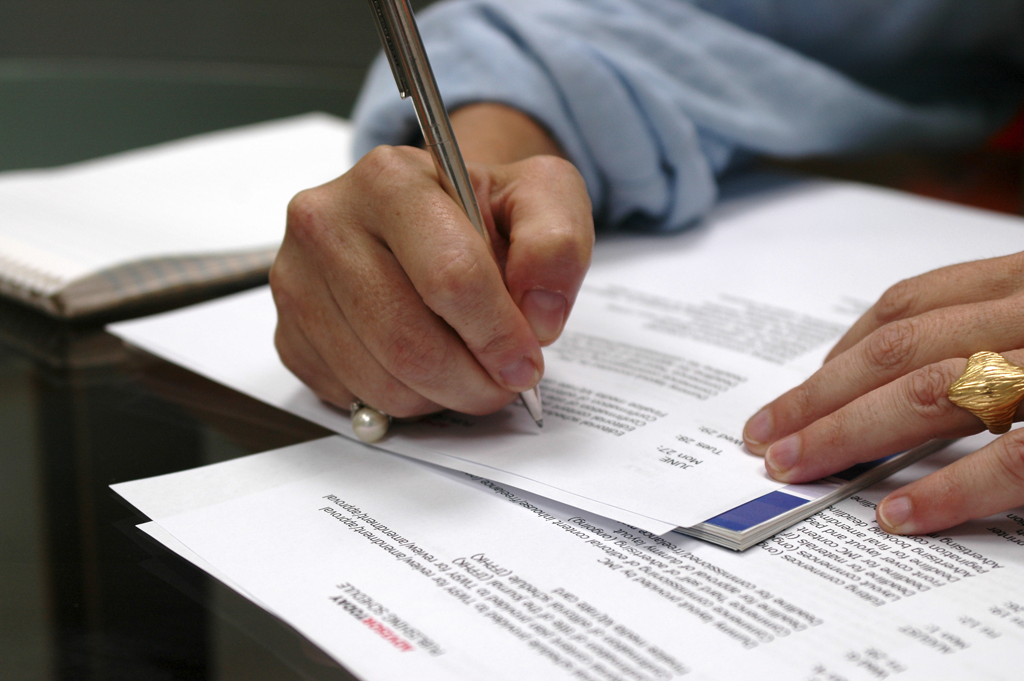



SCOPING THE LITERATURE MANUALLY
I want to read the whole of scientific literature about terpene synthases…
4505 papers
Find and Download
Read and annotate
Comprehend, interpret and infer
1
2
3
Many grad students spend 2 months time on their reviews!
Notes:
This Photo by Unknown Author is licensed under CC BY-SA-NC
This Photo by Unknown Author is licensed under CC BY-SA
This Photo by Unknown Author is licensed under CC BY-SA-NC

Slide 11




SCOPING THE LITERATURE AUTOMATICALLY
CEVOpen Tools can help!
pygetpapers -q "terpene synthase" -n
INFO: Total number of hits for the query are 4505
Find and Download
Read and annotate
Comprehend, interpret and infer
1
2
3
Takes few minutes!
Notes:
This Photo by Unknown Author is licensed under CC BY-SA-NC
This Photo by Unknown Author is licensed under CC BY-SA-NC
This Photo by Unknown Author is licensed under CC BY-SA

Slide 12
Dictionaries are mining tools!
2021 - a sustainable future for Wikidata

Slide 13
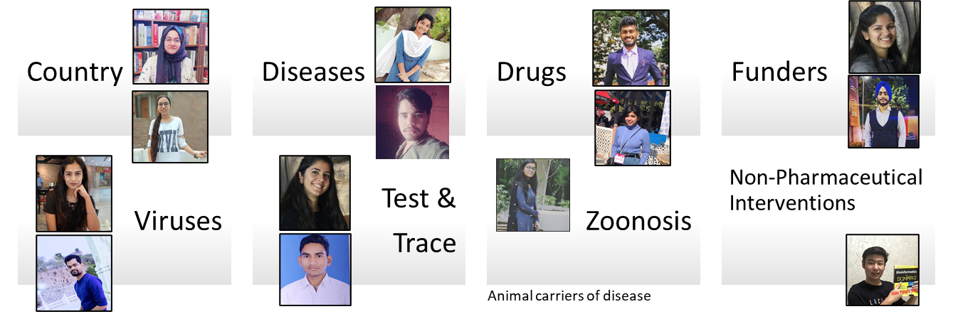


OpenVirus Dictionary
Multilingual!
Slide Credits: Ambreen Hamadani
Credits: MS PowerPoint 3D Models; Wikipedia (https://en.wikipedia.org)
Notes:
Wikidata and Wikipedia globe
Slide for minicopus
Image of the people involved in each project
Numbers if we do not limit the search
Picture of local machines

Slide 14
Plants Dictionary (CEVOpen)
<entry term="cone“ wikidataURL="http://www.wikidata.org/entity/Q22710" wikidataID="Q22710" wikipediaPage="https://en.wikipedia.org/wiki/Conifer_cone">
<synonym>Cone, Conifer cones, Strobilus, pine cone, pine-cone, pinecone, pine cones</synonym>
<synonym xml:lang="zh">松球</synonym>
<synonym xml:lang="de">Koniferenzapfen</synonym>
<synonym xml:lang="hi">कोणधारी कोण</synonym>
<synonym xml:lang="es">cono</synonym>
<synonym xml:lang="fr">cône</synonym>
<description xml:lang="fr">organe reproducteur des conifères</description>
<description xml:lang="es">estructura vegetal</description>
</entry>
term
Multilingual entries
Credits: Vasant Kumar

Slide 15
Workflow
Download Literature
Search literature using dictionaries
Create Dictionaries
Link to Wikimedia

Slide 16
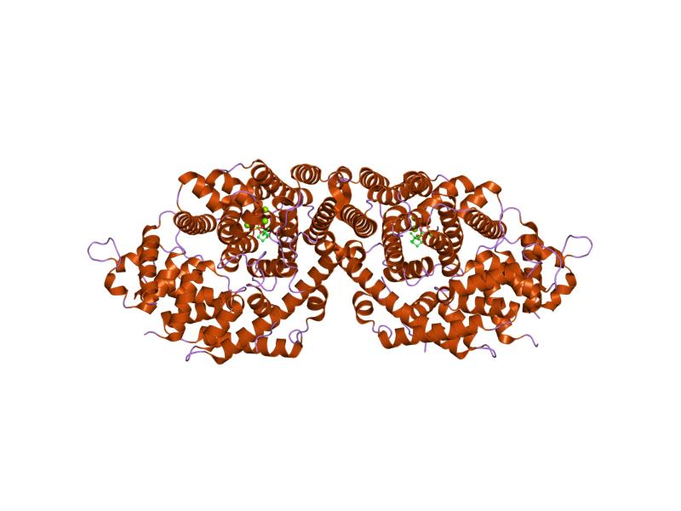
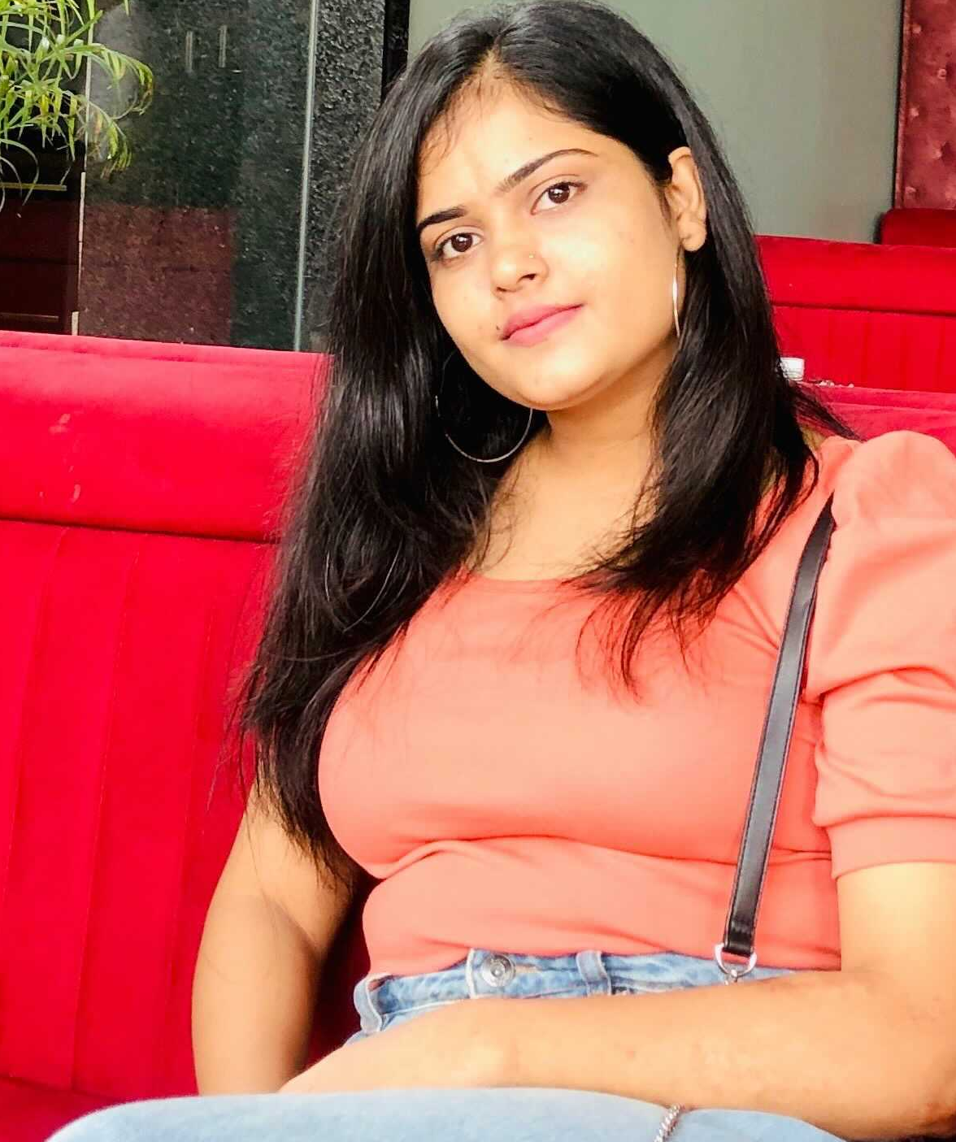

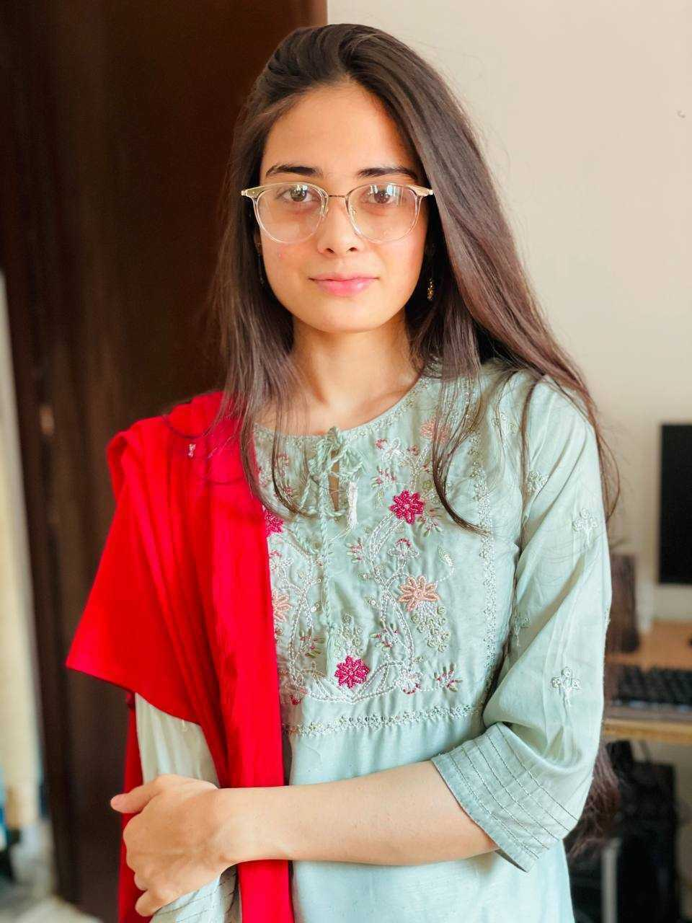
CORN
TOMATO
MINT
GRAPES
CAMELLIA
LEMON
Prachi Singh
Anam Anjum
Anjali Shekhawat
Kumari Rageshwari
Undergrad (Botany), Janki Devi Bajaj Girls Govt. College, Kota
Masters (Botany) Student, Janki Devi Bajaj Government Girls Science College Kota
Masters (Botany) Student,
Jai Narain Vyas University,
Jodhpur, Rajasthan, India.
Masters (Biotech) Student,
Botany Department in University of Rajasthan
Mining Plant Chemistry Literature
KARYA (Knowledge Augmentation through Research in Young Aspirants) Interns
2021 - a sustainable future for Wikidata
https://en.wikipedia.org/wiki/Terpene_synthase_N_terminal_domain , CC BY-SA
Notes:
This Photo by Unknown Author is licensed under CC BY-SA

Slide 17

Next up: Prachi Singh
2021 - a sustainable future for Wikidata

Slide 18
Creating Dictionaries from Wikidata SPARQL
Our Mining tool created from Wikidata!
Prachi Singh
KARYA Intern
CORN मक्का
2021 - a sustainable future for Wikidata

Slide 19

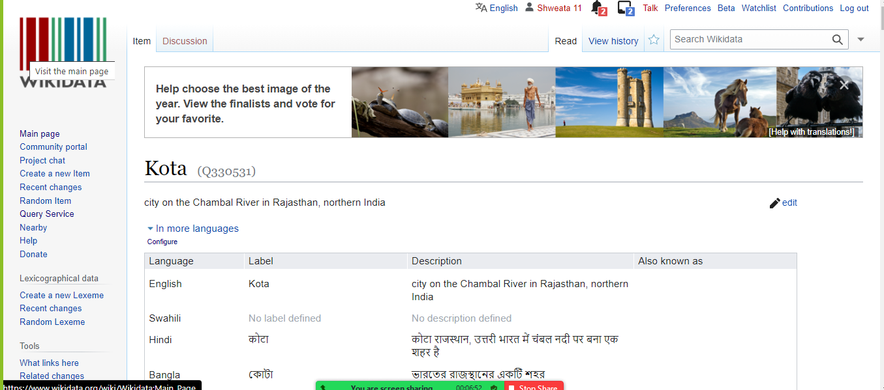
About Me - Prachi Singh (प्राची सिंह)
From: Kota (Q330531), Rajasthan
Bachelors (Botany) from Janki Devi Bajaj Girls Government College, Rajasthan, India.
Joined CEVOpen in Sep. 2021
Working hard to learn – open source tools and open science
2021 - a sustainable future for Wikidata

Slide 20

Workflow
Download Literature
Search literature using dictionaries
Create Dictionaries
Create Dictionaries
SPARQL method
Link to Wikimedia
Notes:
This Photo by Unknown Author is licensed under CC BY-SA

Slide 21


Dictionary creation using Wikidata
Dictionary
ami dict
2021 - a sustainable future for Wikidata
This Photo by Unknown Author is licensed under CC BY-SA

Slide 22
SPARQL Query
https://w.wiki/4HEb
#diterpenes
SELECT ?item ?itemLabel
WHERE
{
?item wdt:P31 wd:Q59447. # instance of diterpene
SERVICE wikibase:label { bd:serviceParam wikibase:language "[AUTO_LANGUAGE],en". } # Helps get the label in your language, if not, then en language
}
2021 - a sustainable future for Wikidata

Slide 23
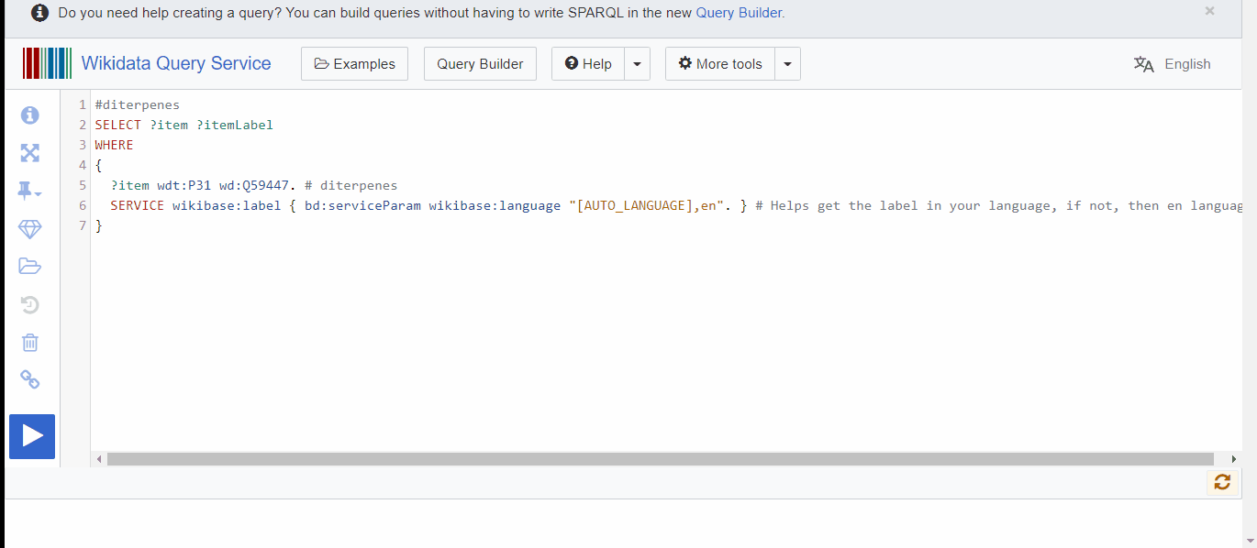
SPARQL Demo
2021 - a sustainable future for Wikidata

Slide 24
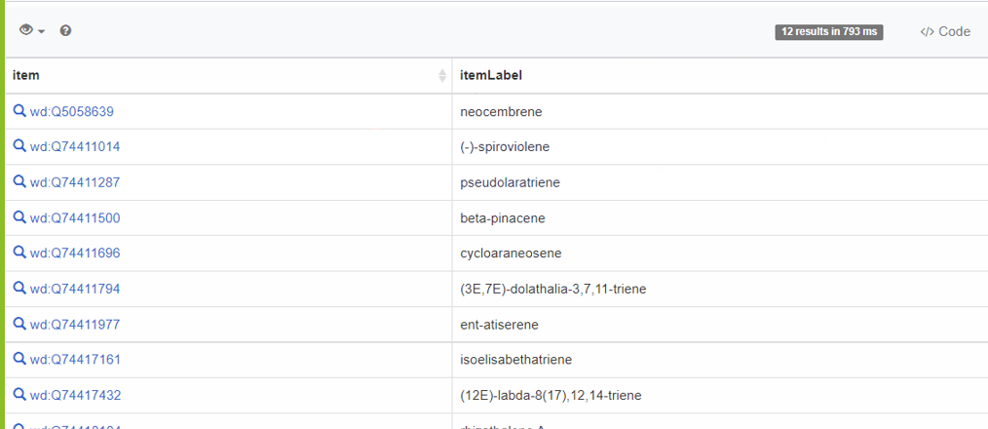
SPARQL Results

Slide 25
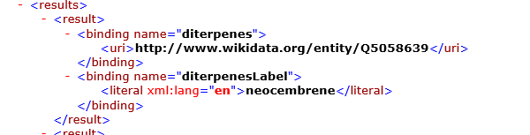
SPARQL Endpoint (XML)
Wikidata ID
These go into the dictionary…
2021 - a sustainable future for Wikidata

Slide 26
One last step:`ami-dict` to convert into dictionary
D:\diterpene_dictionary>amidict -vv
--dictionary diterpenes
--directory ami_terpene_dict
--input diterpene_sparql_out.xml
create --informat wikisparqlxml
--sparqlmap # map SPARQL output to AMIDict
wikidataURL=diterpenes,
term=diterpenesLabel,
--transformName wikidataID=EXTRACT(wikidataURL,.*/(.*))
2021 - a sustainable future for Wikidata

Slide 27
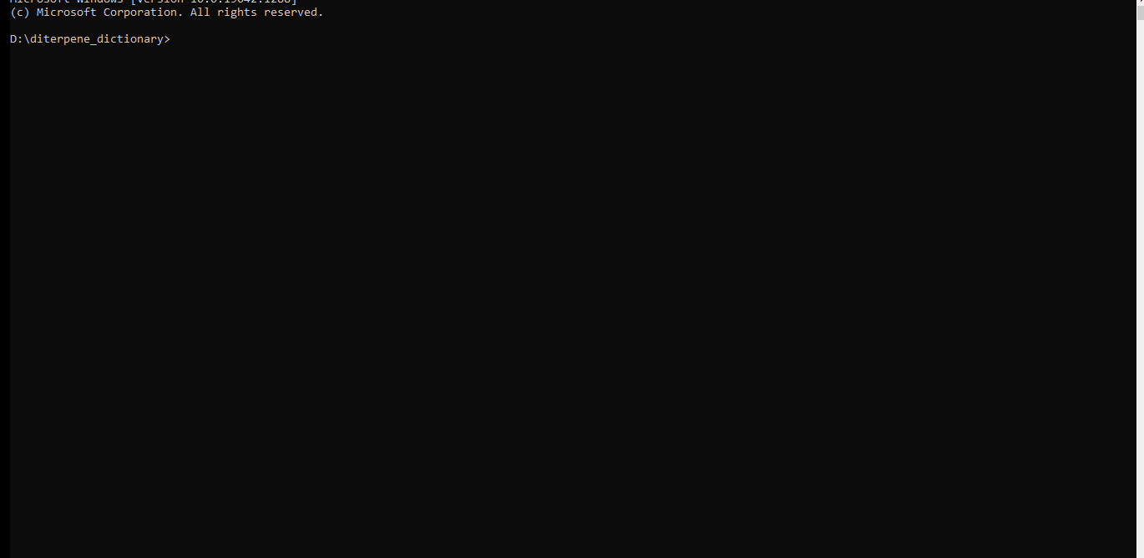
One last step: ami-dict to convert into dictionary

Slide 28
Final Dictionary!
Term
Wikidata ID
<entry wikidataID="Q5058639" wikidataURL="http://www.wikidata.org/entity/Q5058639" term="neocembrene"/>
<entry wikidataID="Q74411014" wikidataURL="http://www.wikidata.org/entity/Q74411014" term="(-)-spiroviolene”/>
<entry wikidataID="Q74411287" wikidataURL="http://www.wikidata.org/entity/Q74411287" term="pseudolaratriene" />
Ready to go off and annotate the scientific literature!
2021 - a sustainable future for Wikidata

Slide 29
My challenges
Java GitHub
EPMC Command line tools
Environment variables
Collaboration Wiki …
Transition
6 weeks ago
Now
Very little coding experience
Basic Python, Java, Git
2021 - a sustainable future for Wikidata

Slide 30
Thanks for your attention!
Useful Links
https://github.com/petermr/openVirus/wiki/openVirus:-SPARQL-queries-of-four-core-dictionaries
https://github.com/petermr/crops/wiki/Zea-mays-TPS-:-Prachi-Singh
https://www.wikidata.org/wiki/Wikidata:SPARQL%2520tutorial
Credits
OpenVirus and CEVOpen Team
2021 - a sustainable future for Wikidata

Slide 31
Workflow
Download Literature
Search literature using dictionaries
Create Dictionaries
Create Dictionaries
Create Dictionaries
Link to Wikimedia

Slide 32
Next up: Anjali Shekhawat
2021 - a sustainable future for Wikidata

Slide 33
Creating Dictionaries from scientific literature
Enhanced with Wikidata
Anjali Shekhawat
KARYA Intern
Mint पुदिना ಪುದಿನ
LEMON नींबू
2021 - a sustainable future for Wikidata

Slide 34
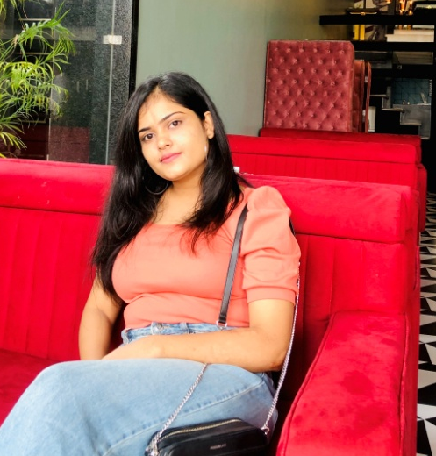
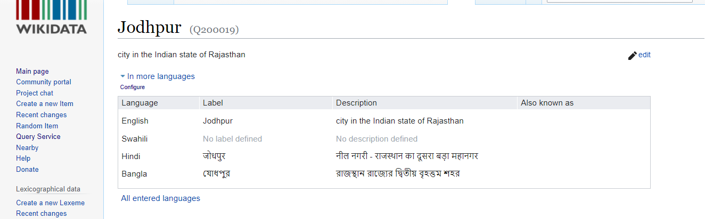
About Me – Anjali Shekhawat (अंजलि शेखावत)
Masters (Botany) from , Jai Narain Vyas University of Jodhpur (Q200019), Rajasthan
Joined CEVOpen in Sep. 2021
Learnt about:
- Wikidata and other open source tools at CEVOpen
2021 - a sustainable future for Wikidata

Slide 35
Workflow
Download Literature
Search literature using dictionaries
Create Dictionaries
Create Dictionaries
Terms linked to Wikidata
Link to Wikimedia
Notes:
This Photo by Unknown Author is licensed under CC BY-SA

Slide 36
What are Dictionaries – Annotating Tools
Set of terms of our interest
compounds, plants, country, disease, genes, and so on
Used to annotate the scientific literature
... Previous studies on the floral volatile organic compounds of M. officinalis at different flowering stages revealed that terpenes were the main constituents, with the highest content of monoterpenes and sesquiterpenes such as camphene (C₁₀H₁₆), D-limonene (C₁₀H₁₆), myrcene (C₁₀H₁₆), and caryophyllene (C₁₅H₂₄) (Wang et al., 2011). Terpenes are the largest class of floral components, of which the terpene synthase (TPS) genes are the key genes that determine the spatiotemporal release of volatile compounds (Gao et al., 2018). The involvement of TPS in the production of floral fragrance has been demonstrated in various plants (Muhlemann et al., 2014). A total of 40 putative TPS proteins in the M. officinalis genome were annotated according to the conserved domains (PF01397 and PF03936) using HMMER (Potter et al., 2018). We constructed a phylogenetic tree by aligning the TPS proteins among M. officinalis, M. biondii, L. chinense, and A. thaliana to confirm the classification of TPS family proteins in M. officinalis (Figure 8B). According to the protein phylogenetic tree, the 40 TPS proteins were divided into five groups, which contain TPS-a, TPS-b, TPS-c, TPS-e, and TPS-f. …
Q416775
Q27888324
Q424577
Q421614
Chemicals
Species
Q6731965
Q141303
2021 - a sustainable future for Wikidata
https://europepmc.org/article/MED/34505009

Slide 37
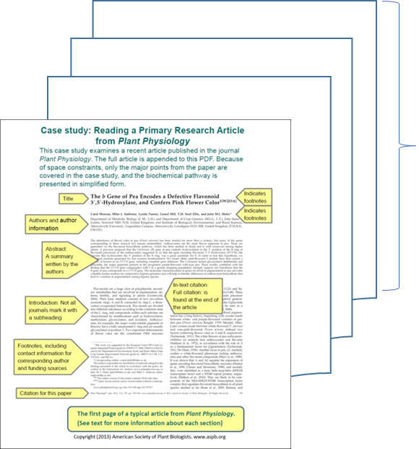
How do we create dictionaries?
Mini-corpora
Collected terpene synthase mentions
ami
diphosphate synthase
valencene synthase
terpene synthase 3
β-ocimene synthase
geranyl diphosphate
monoterpene synthase
…
Look-up Wikidata
X 100
pygetpapers
Terpene Synthase literature on Mentha (Mint)
Text file
2021 - a sustainable future for Wikidata

Slide 38
Last step:`ami-dict` to convert into dictionary
amidict -v
--dictionary terpene_synthase
--directory terpene_synthase_dir
--input terpene_synthase.txt
create
--informat list
--outformats xml
2021 - a sustainable future for Wikidata

Slide 39
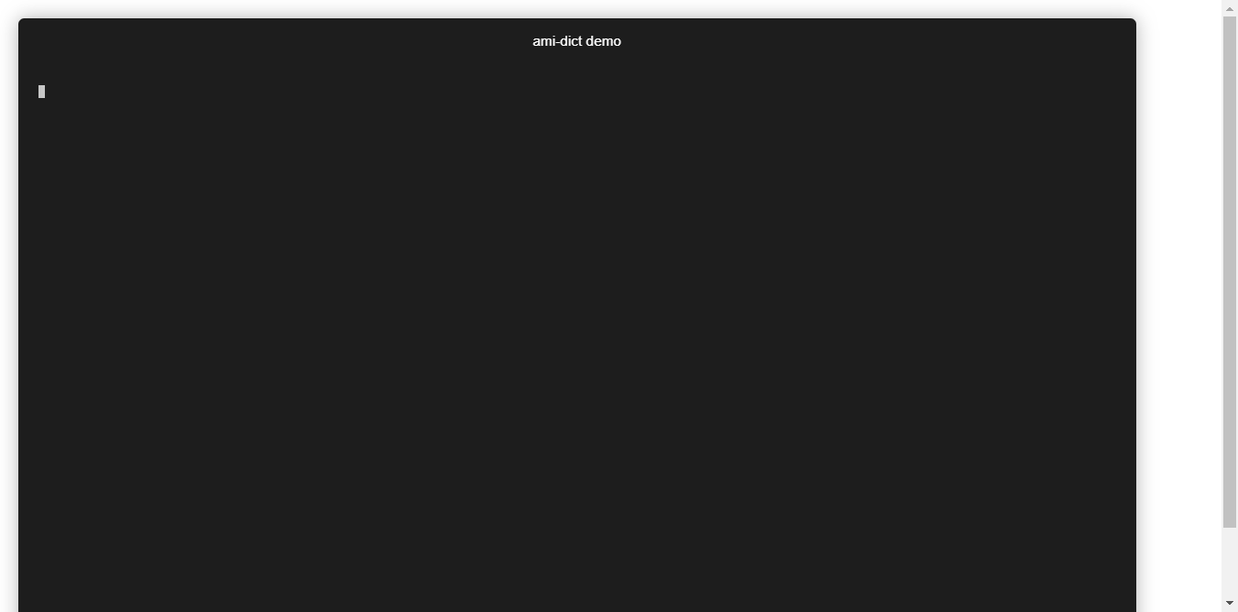
Last step:`ami-dict` to convert into dictionary

Slide 40
Final Dictionary!
term
Wikidata ID
…
<entry term="diphosphate synthase“ WikidataID = “Q18648706”/>
<entry term="valencene synthase WikidataID = “Q13405193”"/>
<entry term=“geranyl diphosphate” WikidataID = “Q23340835”"/>
…
Ready to go off and annotate the scientific literature!
2021 - a sustainable future for Wikidata
Notes:
Look up the Wikidata ID for the chemicals

Slide 41

Learning Experience
Teamwork
Communally solving problems made learning to run tools fun!
2021 - a sustainable future for Wikidata

Slide 42
Workflow
Download Literature
Search literature using dictionaries
Create Dictionaries
Create Dictionaries
Create Dictionaries
Link to Wikimedia

Slide 43
Next up: Anam Anjum
2021 - a sustainable future for Wikidata

Slide 44
Creating Mini-Corpora
How we find and automatically download papers
Anam Anjum
KARYA Intern
TOMATO, टमाटर
CAMELLIA, TEA, चाय
2021 - a sustainable future for Wikidata

Slide 45
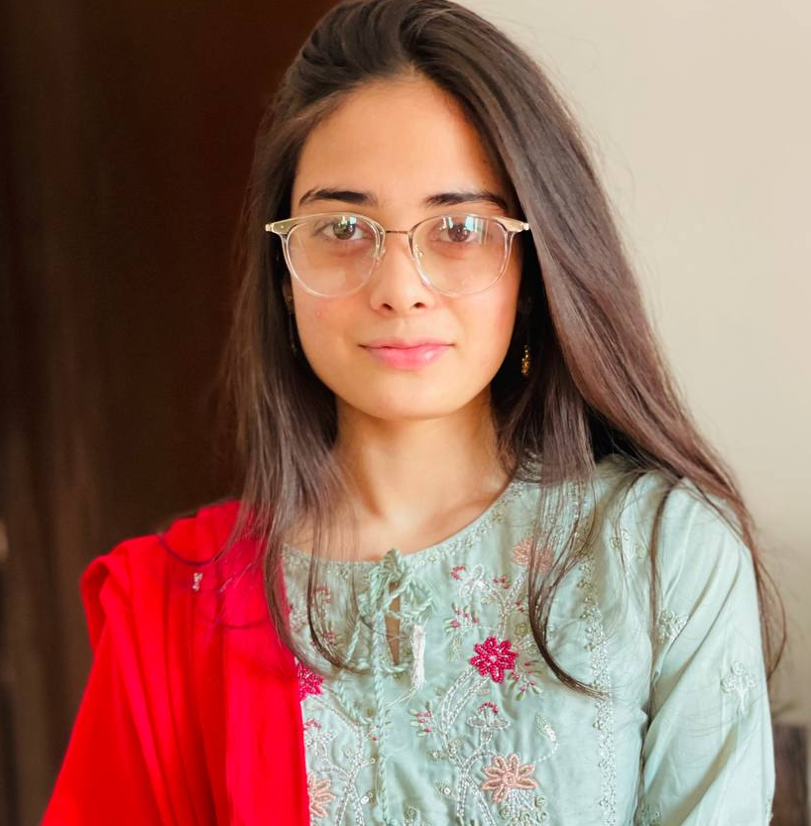
About Me – Anam Anjum - अनम अंजुम
From: Kota (Q330531), Rajasthan
Masters (Botany) from Janki Devi Bajaj Girls Government College, Rajasthan, India.
Joined CEVOpen in Sep. 2021
Work on creating dictionaries
2021 - a sustainable future for Wikidata

Slide 46

Workflow
Download Literature
Search literature using dictionaries
Create Dictionaries
Download Literature
Create Dictionaries
Create Dictionaries
Link to Wikimedia

Slide 47

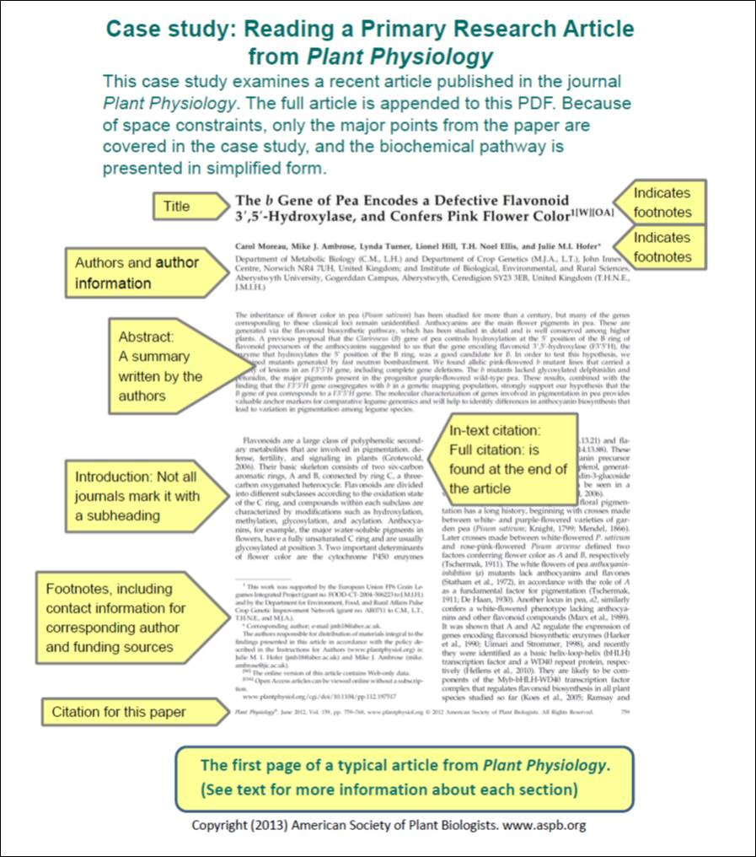

1. Mini-corpora
Has millions of open access papers.
*
X 1000
Open Repository
pygetpapers
Downloads hundreds of papers in minutes
Preprint Servers
On local machines.
Credits; Ayush Garg and Richard D Smith-Unna
2021 - a sustainable future for Wikidata
http://www.seer.ufu.br/index.php/sociedadenatureza/issue/view/1922is licensed under CC BY
This Photo by Unknown Author is licensed under CC BY-NC
Notes:
5 million open access paper. (EPMC)

Slide 48
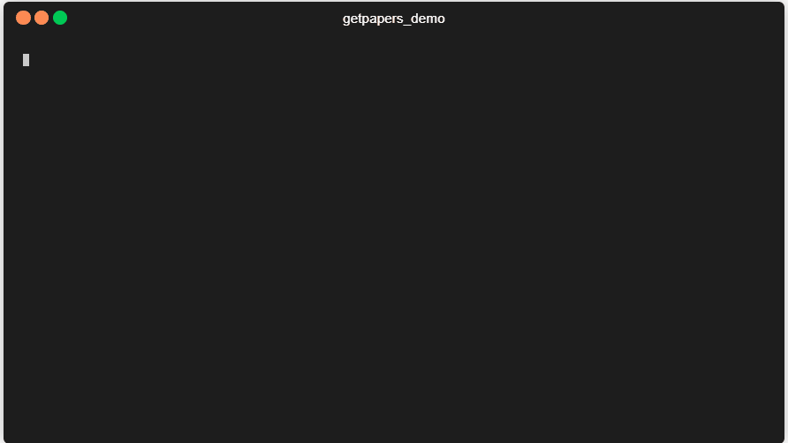
pygetpapers query
pygetpapers -q "terpene synthase AND MENTHA(((SRC:MED OR SRC:PMC OR SRC:AGR OR SRC:CBA) NOT (PUB_TYPE:"Review")))" -k 80 -x -o TPS_mentha
2021 - a sustainable future for Wikidata

Slide 49
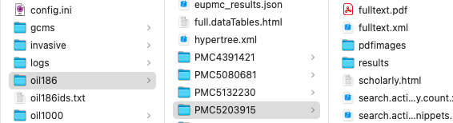
Minicorpus
Folder containing papers
Mincorpus
Fulltext

Slide 50


My progress
Plant science student
Literate about open tools
55 days
https://github.com/petermr/crops/wiki/TPS-Reserve-For-Camellia-and-Tomato-Crop
2021 - a sustainable future for Wikidata

Slide 51



Experience
Creative team
Help each other
Learn from mistakes
Team work
2021 - a sustainable future for Wikidata

Slide 52
Workflow
Download Literature
Search literature using dictionaries
Create Dictionaries
Download Literature
Create Dictionaries
Create Dictionaries
Link to Wikimedia

Slide 53
Next up: Kumari Rageshwari
2021 - a sustainable future for Wikidata

Slide 54
ami-search
How it all fits together
GRAPES अंगूर
Kumari Rageshwari
KARYA Interns
2021 - a sustainable future for Wikidata

Slide 55
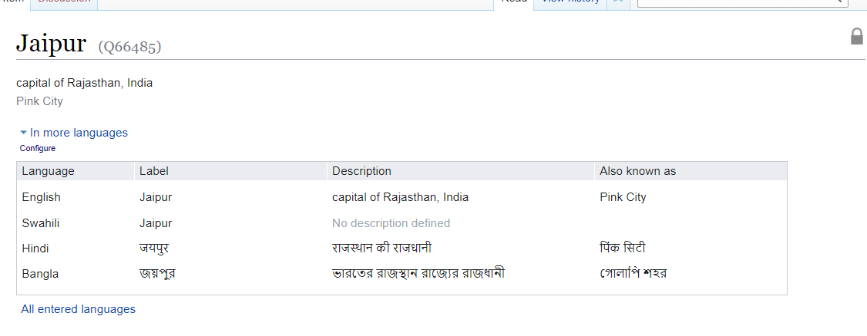
About Me - Kumari Rageshwari (कुमारी रागेश्वरी)
Masters (Biotechnology) from Botany Department, University of Rajasthan, Jaipur(Q66485)
2021 - a sustainable future for Wikidata
https://www.wikidata.org/wiki/Q66485

Slide 56

Workflow
Search literature using dictionaries
Download Literature
Search literature using dictionaries
Create Dictionaries
Download Literature
Create Dictionaries
Create Dictionaries
Link to Wikimedia

Slide 57
ami-search using eoTPS dictionary
minicorpus
ami -p "TPSvolatile"
search
--dictionary eo_Gene.xml
dictionary
2021 - a sustainable future for Wikidata

Slide 58
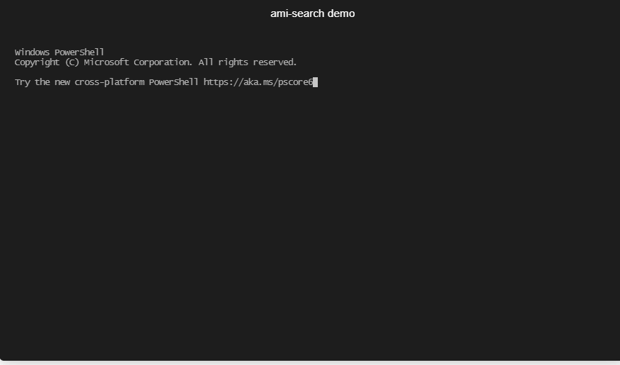
ami-search using eoTPS dictionary
2021 - a sustainable future for Wikidata

Slide 59
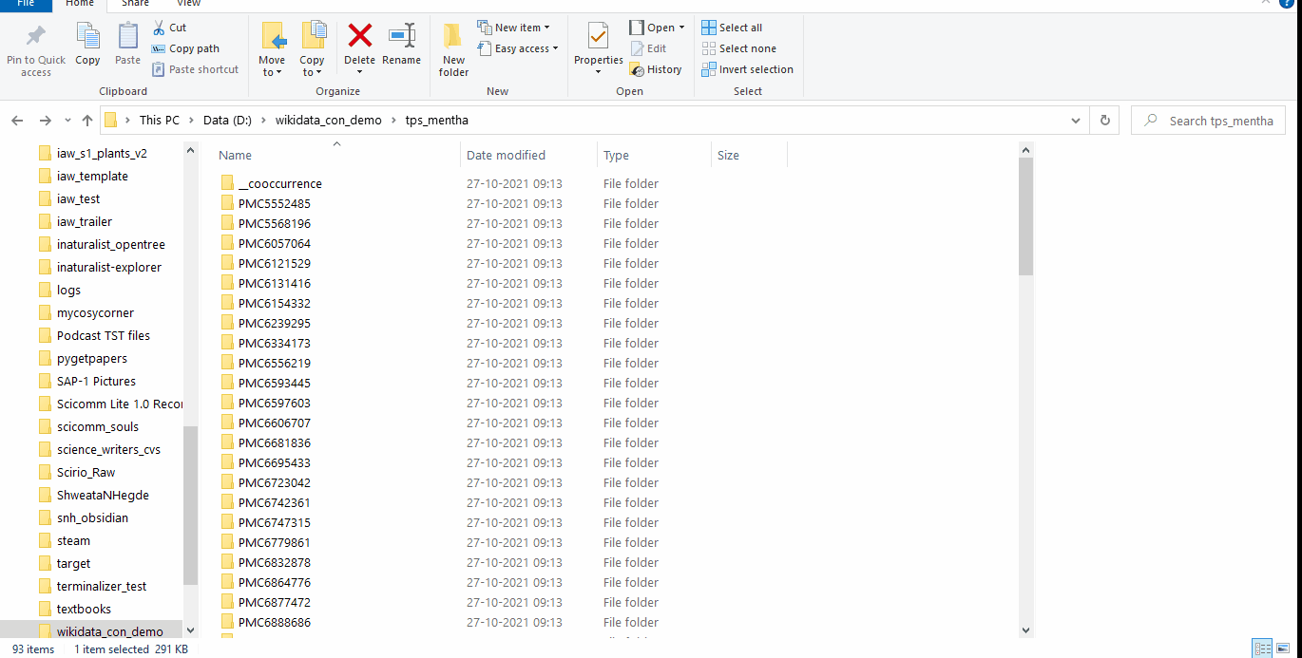
Dashboard
Semantic Papers
2021 - a sustainable future for Wikidata

Slide 60
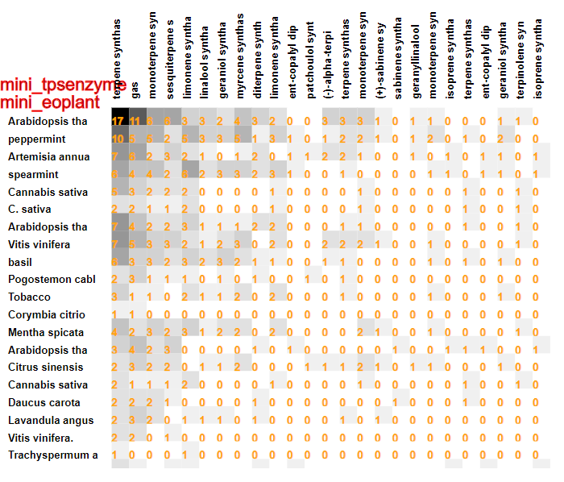
Co-occurrence
2021 - a sustainable future for Wikidata

Slide 61
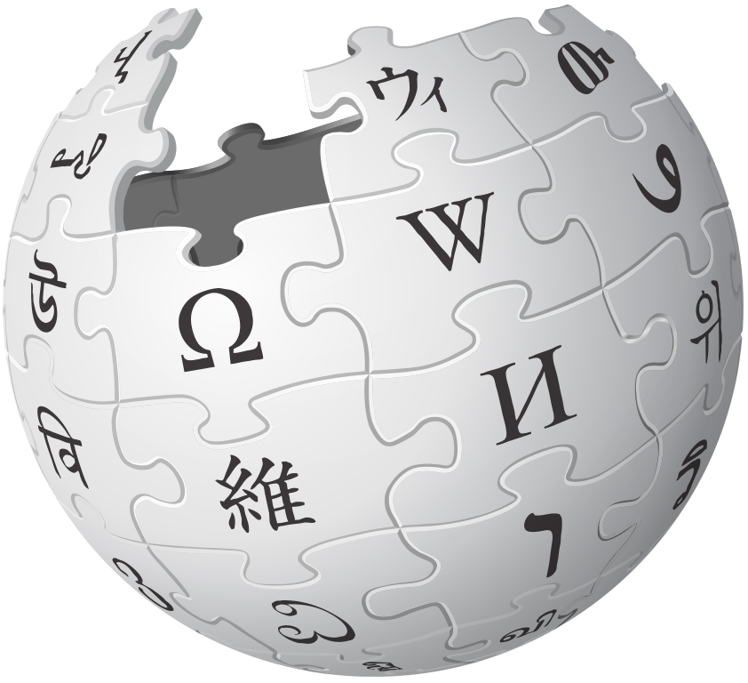
Workflow
Search literature using dictionaries
Download Literature
Search literature using dictionaries
Create Dictionaries
Download Literature
Create Dictionaries
Create Dictionaries
Link to Wikimedia
Link to Wikimedia
Notes:
This Photo by Unknown Author is licensed under CC BY-SA

Slide 62
How we work as a Team!
2021 - a sustainable future for Wikidata

Slide 63
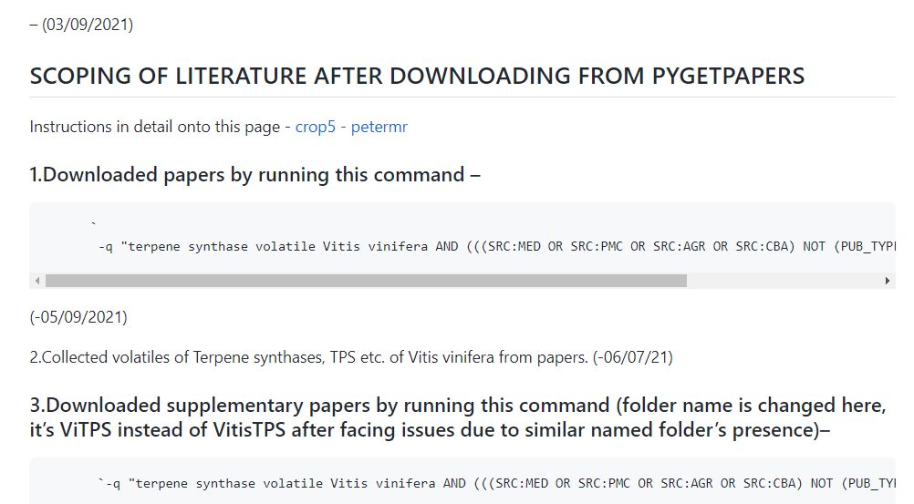
Documentation
We work in the OPEN!
Github Wiki page
2021 - a sustainable future for Wikidata

Slide 64
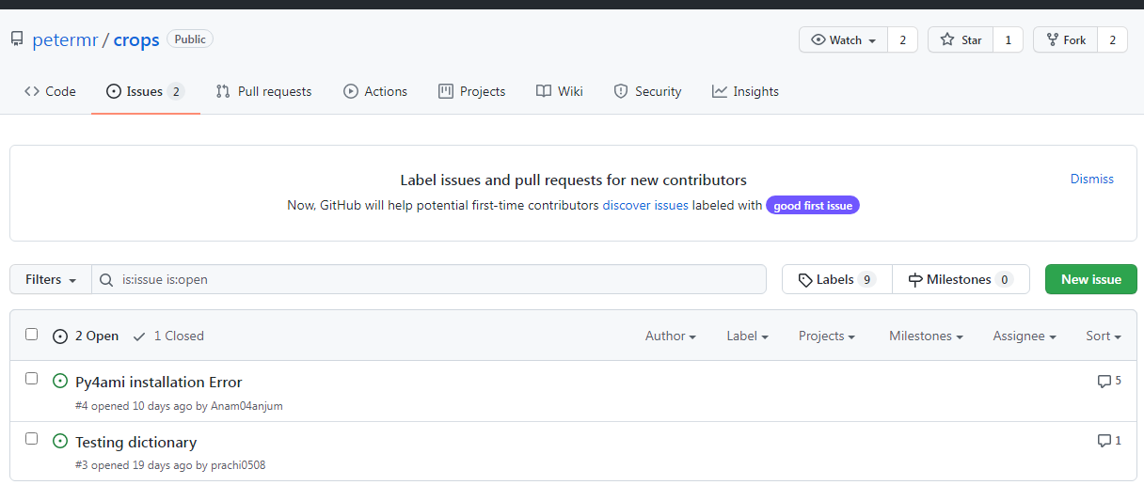
Communal Problem Solving
2021 - a sustainable future for Wikidata

Slide 65
Thanks for your attention!
Every progress reported on wiki –
https://github.com/petermr/crops/wiki/Progress-outline-of-Vitis-vinifera-:-Kumari-Rageshwari
Full data table and link to wikipedia - https://github.com/petermr/crops/blob/main/Vitis%20vinifera/full.dataTables.html
Ami installation procedure documented –
https://github.com/petermr/openVirus/wiki/Documentation-of-getpapers-&-ami
Credits
OpenVirus and CEVOpen
2021 - a sustainable future for Wikidata

Slide 66
Back to Shweata
2021 - a sustainable future for Wikidata

Slide 67
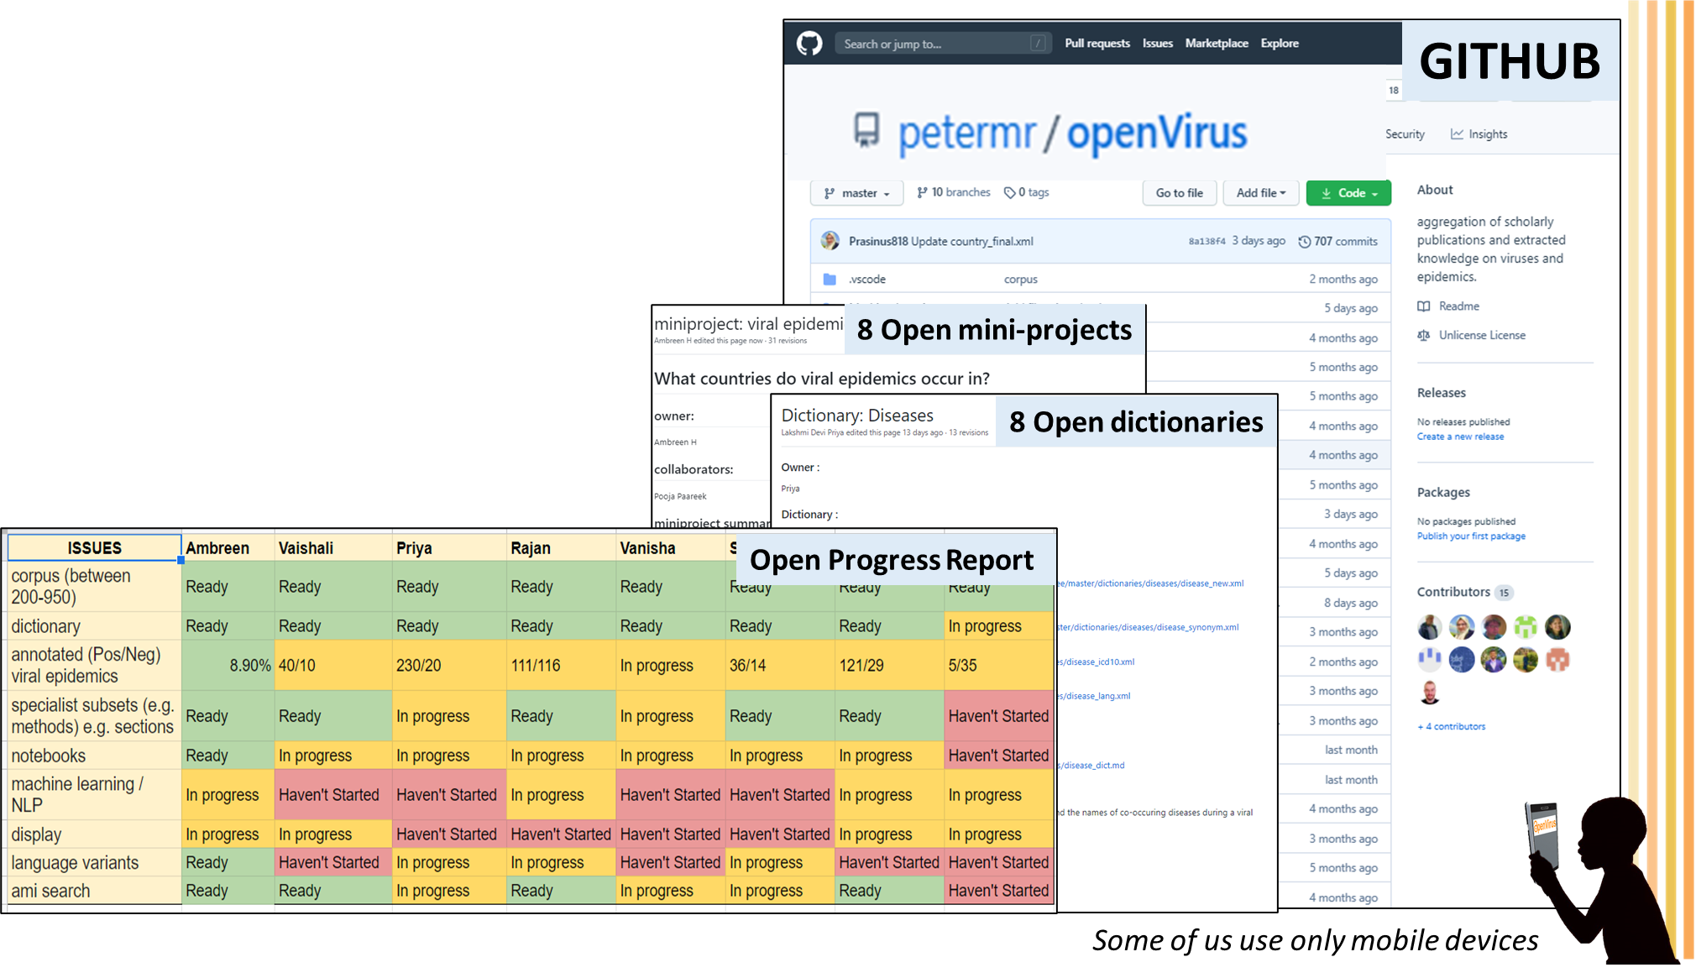

We work in the open
Open Notebook Philosophy
Meet Biweekly (virtually):
Abuzz with Ideas
Update our progress
Show it to the World
Solve problems communally
Slide courtesy: Ambreen
Credits: MS PowerPoint Icons

Slide 68
Workflow
Search literature using dictionaries
Download Literature
Search literature using dictionaries
Create Dictionaries
Download Literature
Create Dictionaries
Create Dictionaries
Link to Wikimedia
Link to Wikimedia
Notes:
This Photo by Unknown Author is licensed under CC BY-SA

Slide 69
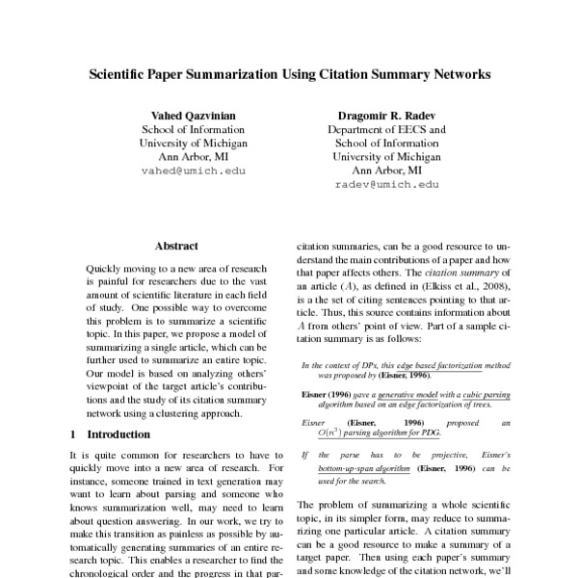
Docanalysis: Feedback Loop
Dictionary
Natural Language Processing and Machine Learning
. L-phenylalanine is converted to 2-phenylacetaldehyde by phenyl acetaldehyde synthase (PAAS). Subsequently, 2-phenylacetaldehyde is reduced to 2-phenylethanol by phenyl acetaldehyde reductase (PAR). Next, 2-phenylethanol is acetylated to 2-phenylethyl acetate by acetyl-coenzyme a: geraniol/citronellol acetyl transferase (AAT)…
. L-phenylalanine is converted to 2-phenylacetaldehyde by phenyl acetaldehyde synthase (PAAS). Subsequently, 2-phenylacetaldehyde is reduced to 2-phenylethanol by phenyl acetaldehyde reductase (PAR). Next, 2-phenylethanol is acetylated to 2-phenylethyl acetate by acetyl-coenzyme a: geraniol/citronellol acetyl transferase (AAT)…
AUTOMATIC
1 paper/s
1000s of Entities
10000 papers
Ayush Garg, Shweata Hegde, Daniel Mietchen
2021 - a sustainable future for Wikidata
https://github.com/petermr/docanalysis
https://europepmc.org/article/MED/34630447#free-full-text
Notes:
This Photo by Unknown Author is licensed under CC BY
This Photo by Unknown Author is licensed under CC BY

Slide 70
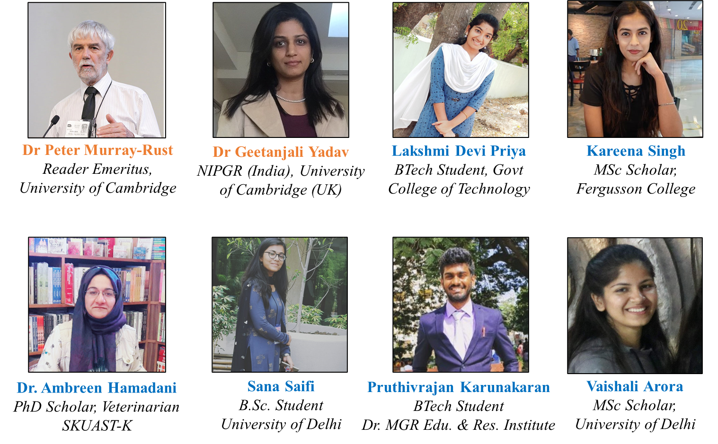
Our Team
Dr Gitanjali Yadav

Slide 71
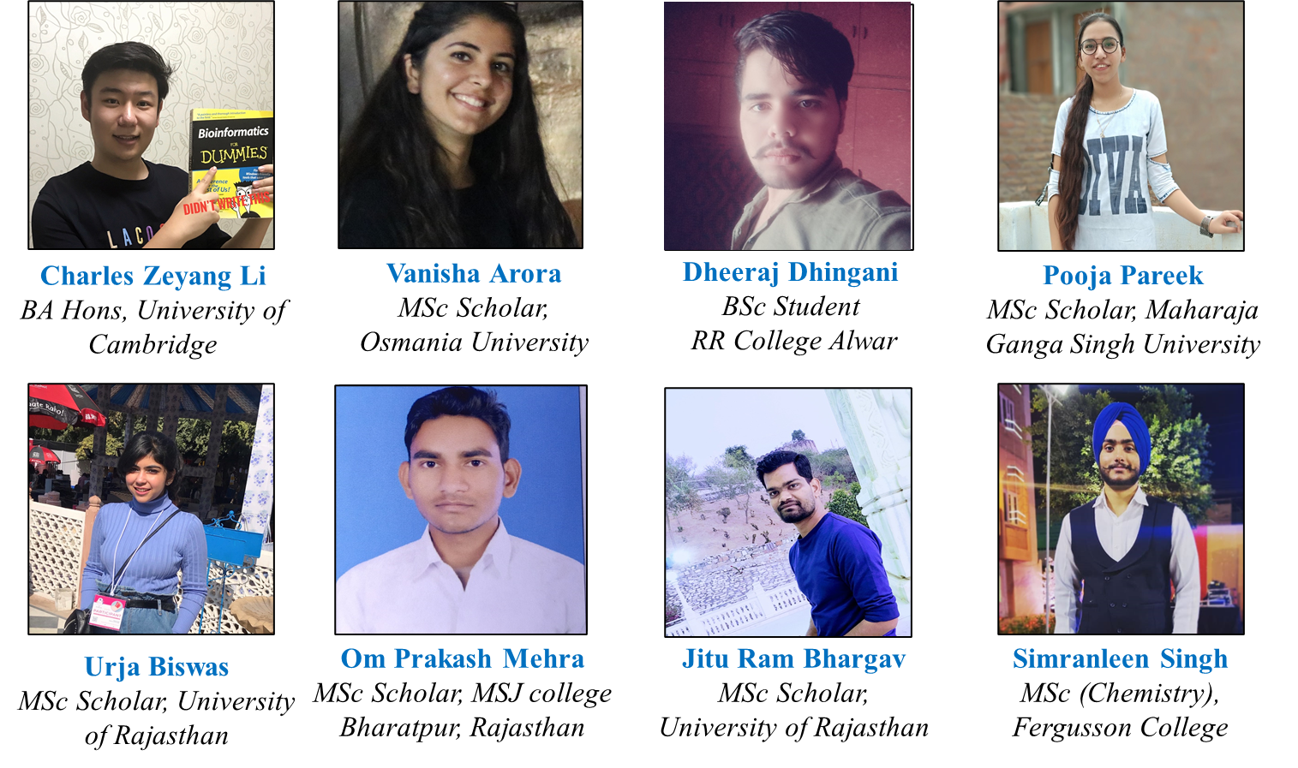
Our Team

Slide 72
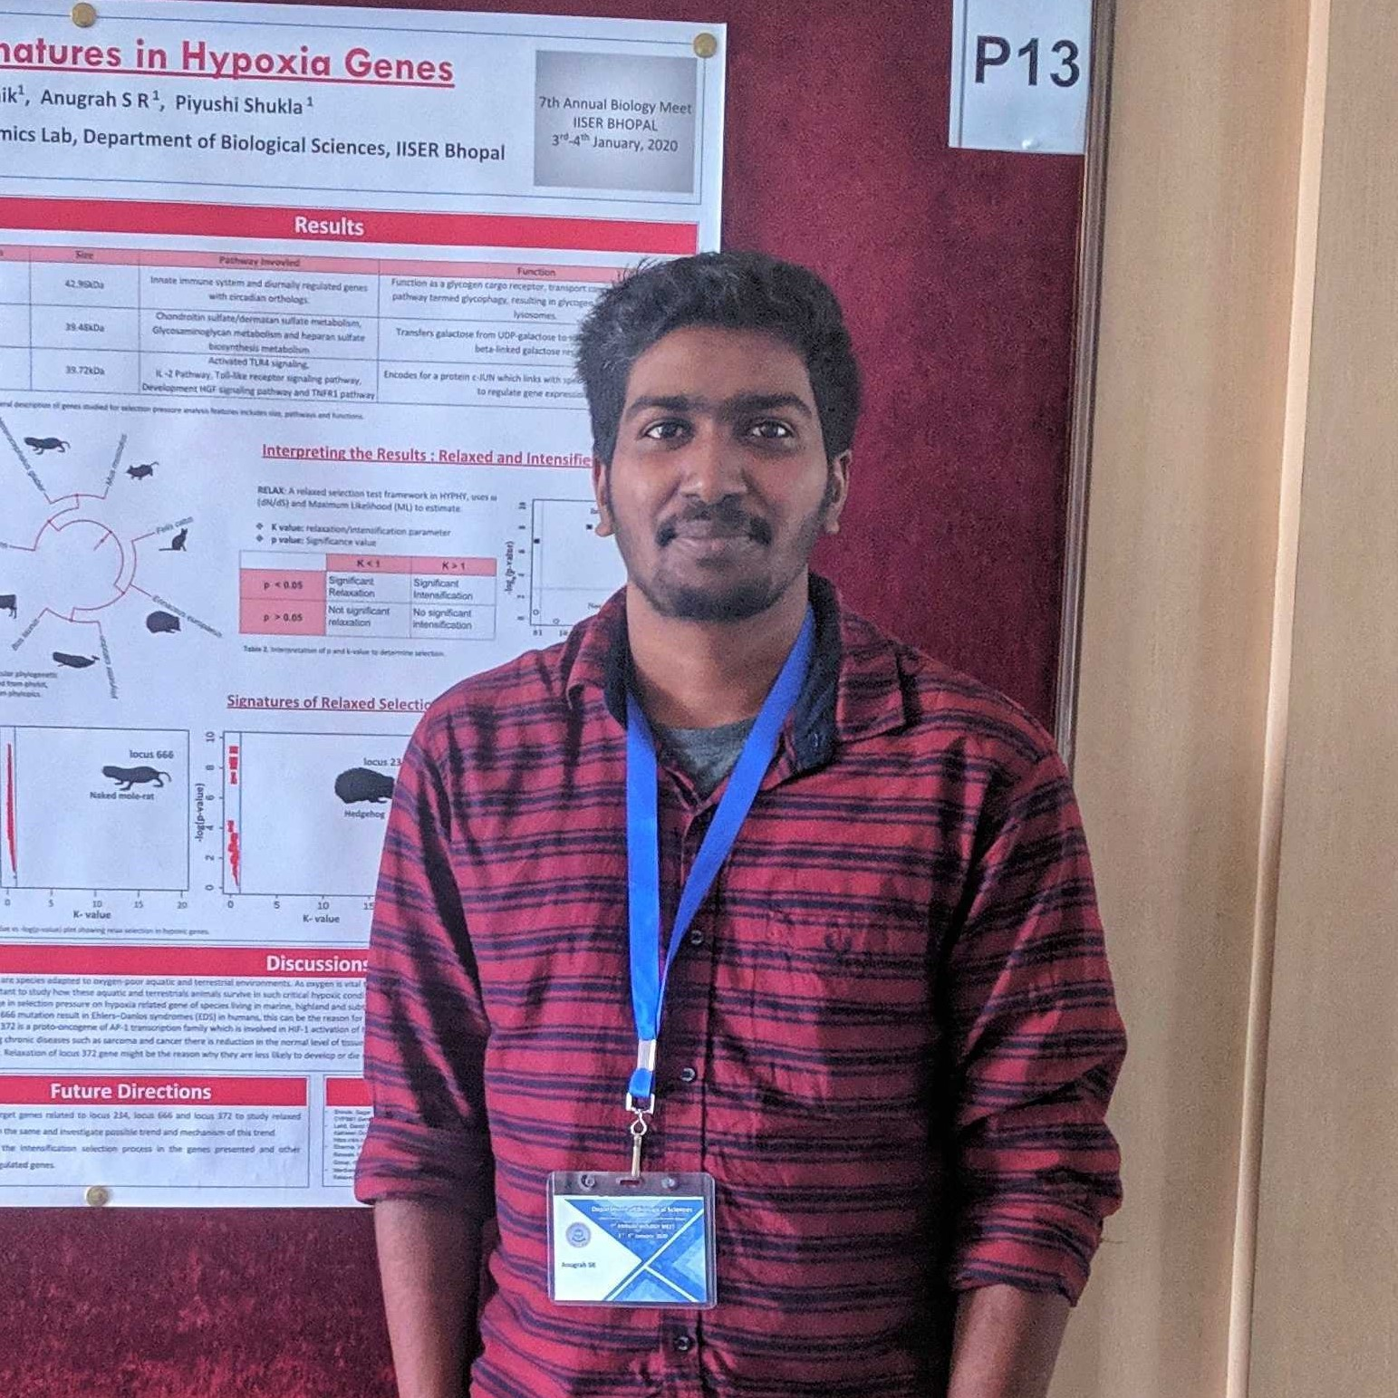
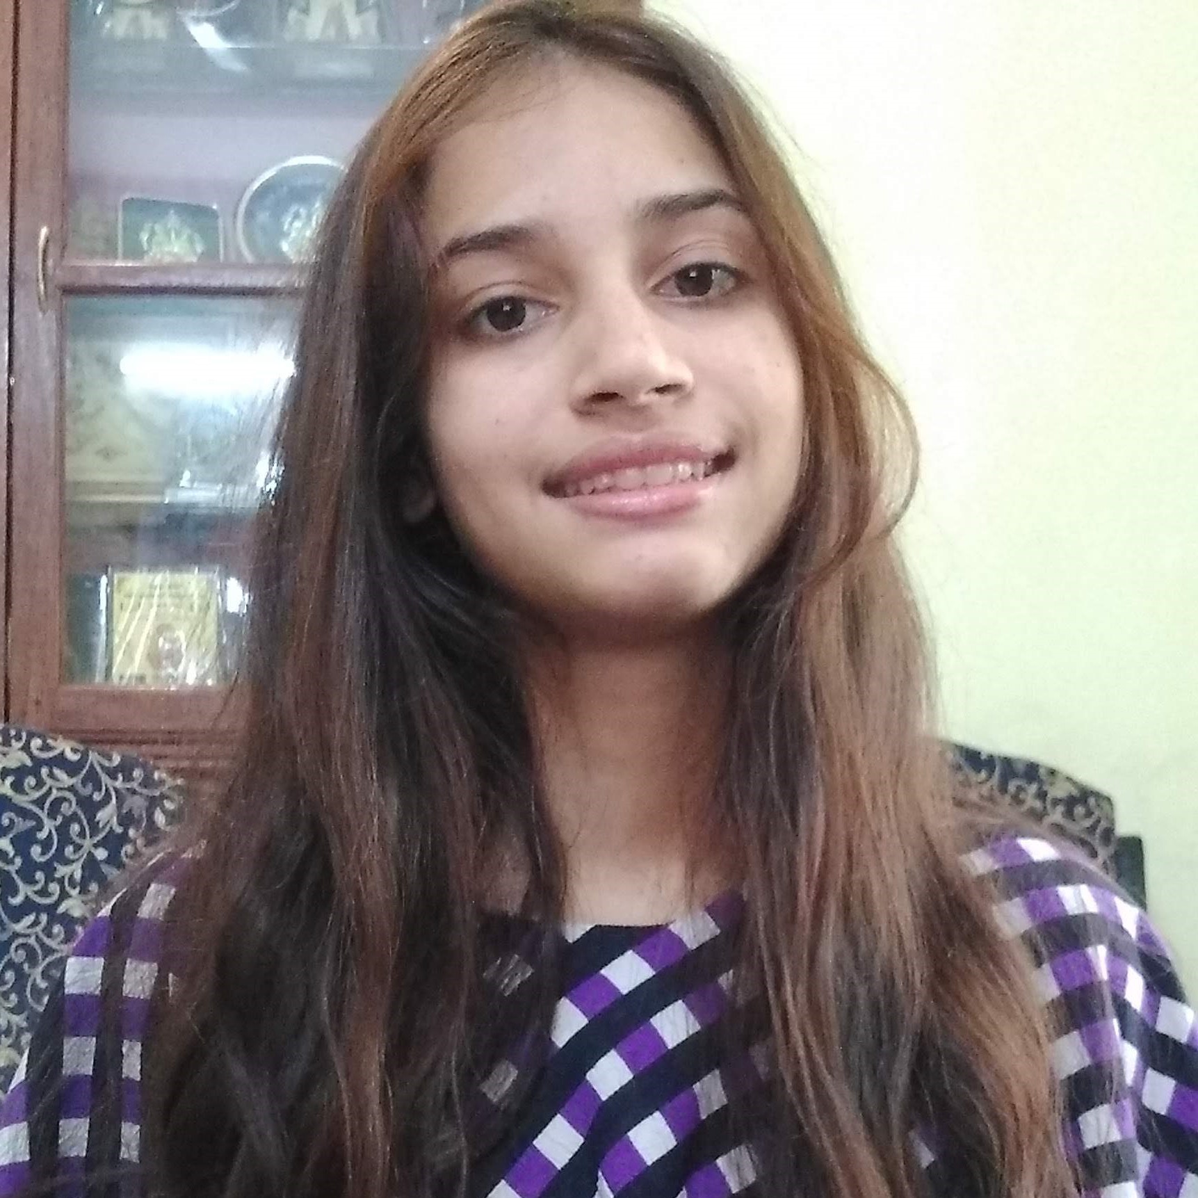
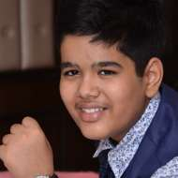




Anugrah S. R.
BS-MS(Biological Sciences) IISER Bhopal
Shweata N. Hegde
BSc Student
Regional Inst. Of Edu. Mysore
Ayush Garg
GIIS Singapore
Kanishka Parashar
MSc Biotech
Jamia Millia Islamia,Delhi
Talha Hasan
MSc Toxicology
Jamia Hamdard University
Radhu Kantilal Ladani
Msc Bioinformatics Rajiv Gandhi Institute, Pune.
Vasant Kumar
M.Sc. Biotech, Himachal Pradesh University, Summerhill

Slide 73



Prachi Singh
Anam Anjum
Anjali Shekhawat
Kumari Rageshwari
Undergrad (Botany), JDB Girls Govt. College, Kota
Masters (Botany) Student, JDB Government Girls Science College Kota
Masters (Botany) Student,
Jai Narain Vyas University,
Jodhpur, Rajasthan, India.
Masters (Biotech) Student,
Botany Department in University of Rajasthan
Anubhab Chakraborty
Undergrad at IISER Bhopal
Ankit Anil Lade
Undergrad at IISER Bhopal
Utkarsha N. Pande
Undergrad at IISER Bhopal

Slide 74
Thanks for your attention!
Thanks to NIPGR and DST Rajasthan
Mentors, openVirus, CEVOpen Team, Global Volunteers and Wikimedia Community!
Credits
Image credits: Microsoft Powerpoint, Wikimedia Commons
2021 - a sustainable future for Wikidata

